Slide 1
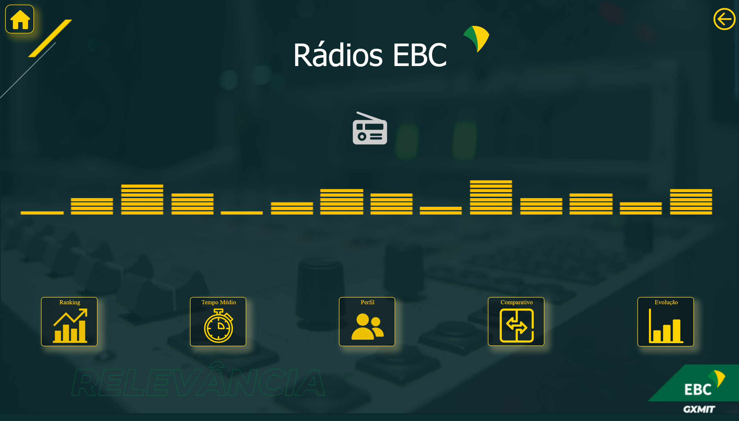
Home
Notes:
image
No alt text provided
textbox
No alt text provided
Gif_Equalizer
No alt text provided
Evolução
No alt text provided
Comparativo
No alt text provided
Tempo Médio
No alt text provided
Perfil
No alt text provided
Ranking
No alt text provided
actionButton
No alt text provided
image
No alt text provided
Icon_radio
No alt text provided

Slide 2
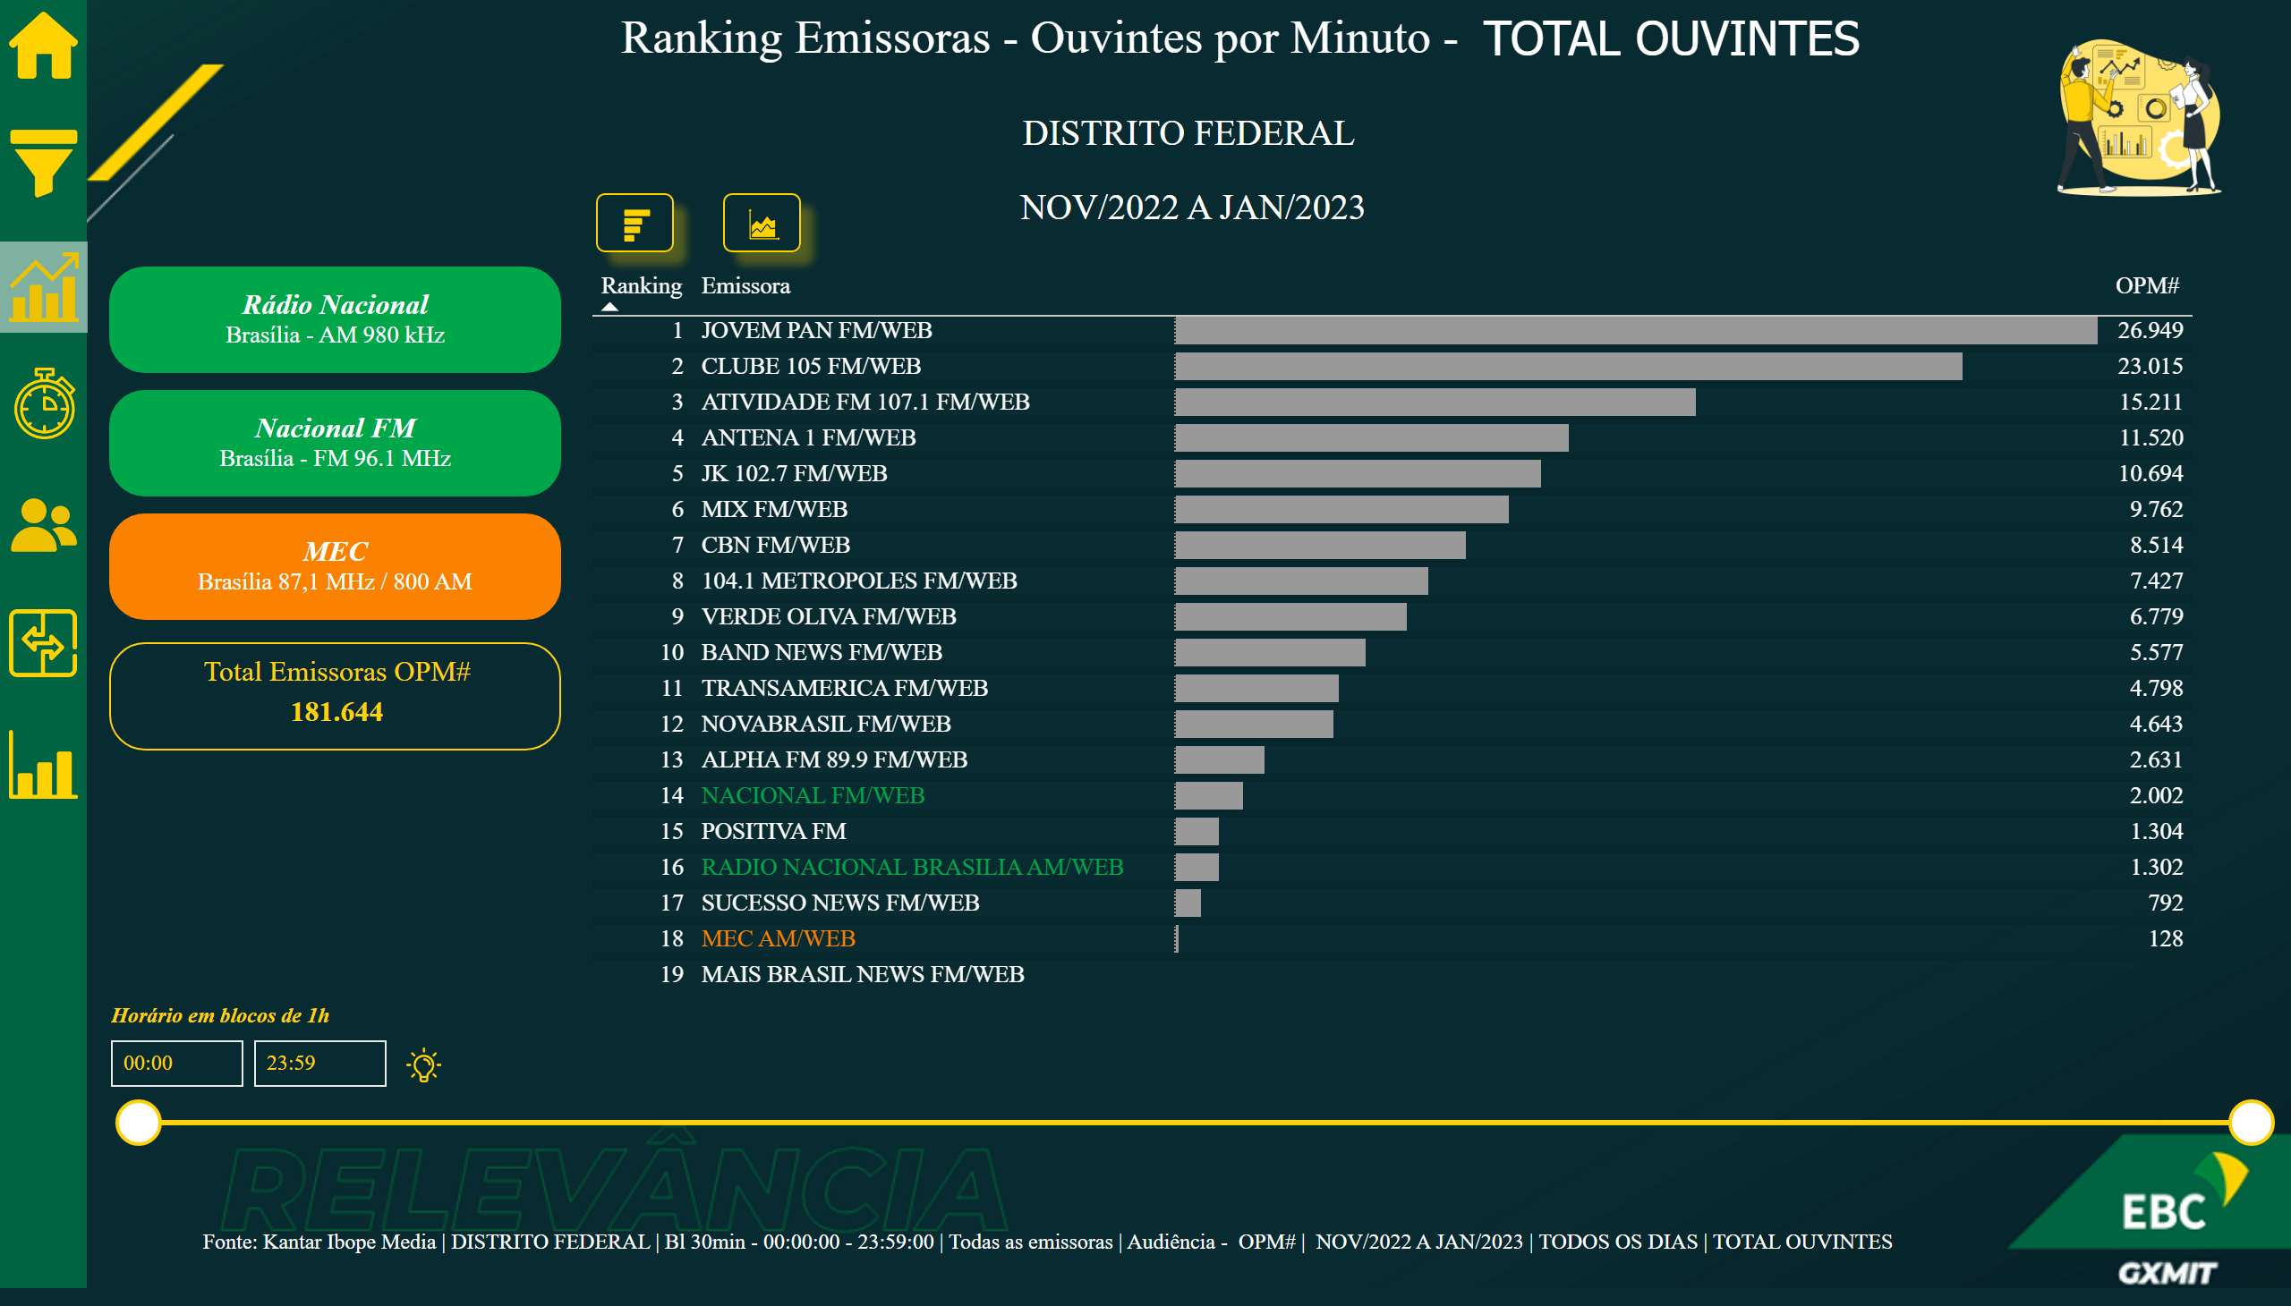
01_DF
Notes:
Tb_bar
No alt text provided
image
No alt text provided
Icon_Dica
No alt text provided
image
No alt text provided
image
No alt text provided
textbox
No alt text provided
shape
No alt text provided
card
No alt text provided
actionButton
No alt text provided
actionButton
No alt text provided
shape
No alt text provided
actionButton
No alt text provided
slicer
No alt text provided
slicer
No alt text provided
slicer
No alt text provided
slicer
No alt text provided
card
No alt text provided
card
No alt text provided
tableEx
No alt text provided
clusteredBarChart
No alt text provided
image
No alt text provided
shape
No alt text provided
image
No alt text provided
image
No alt text provided
image
No alt text provided
image
No alt text provided
image
No alt text provided
image
No alt text provided
image
No alt text provided
card
No alt text provided
card
No alt text provided
card
No alt text provided
advanceCardE03760C5AB684758B56AA29F9E6C257B
No alt text provided
textbox
No alt text provided
Im_Rank
No alt text provided
Im_Eixo
No alt text provided
Total Emissoras OPM#
No alt text provided
shape
No alt text provided
shape
No alt text provided
Icon_TMED
No alt text provided
Icon_Evolucao
No alt text provided
Icon_Comparativo
No alt text provided
Icon_Menu
No alt text provided
Icon_Ranking
No alt text provided
Icon_Perfil
No alt text provided
Icon_Home
No alt text provided
actionButton
No alt text provided
textbox
No alt text provided
actionButton
No alt text provided
textbox
No alt text provided
actionButton
No alt text provided
textbox
No alt text provided
Horário em blocos de 1h
No alt text provided
Fonte
No alt text provided
image
No alt text provided
card
No alt text provided
card
No alt text provided
textbox
No alt text provided
advanceCardE03760C5AB684758B56AA29F9E6C257B
No alt text provided

Slide 3
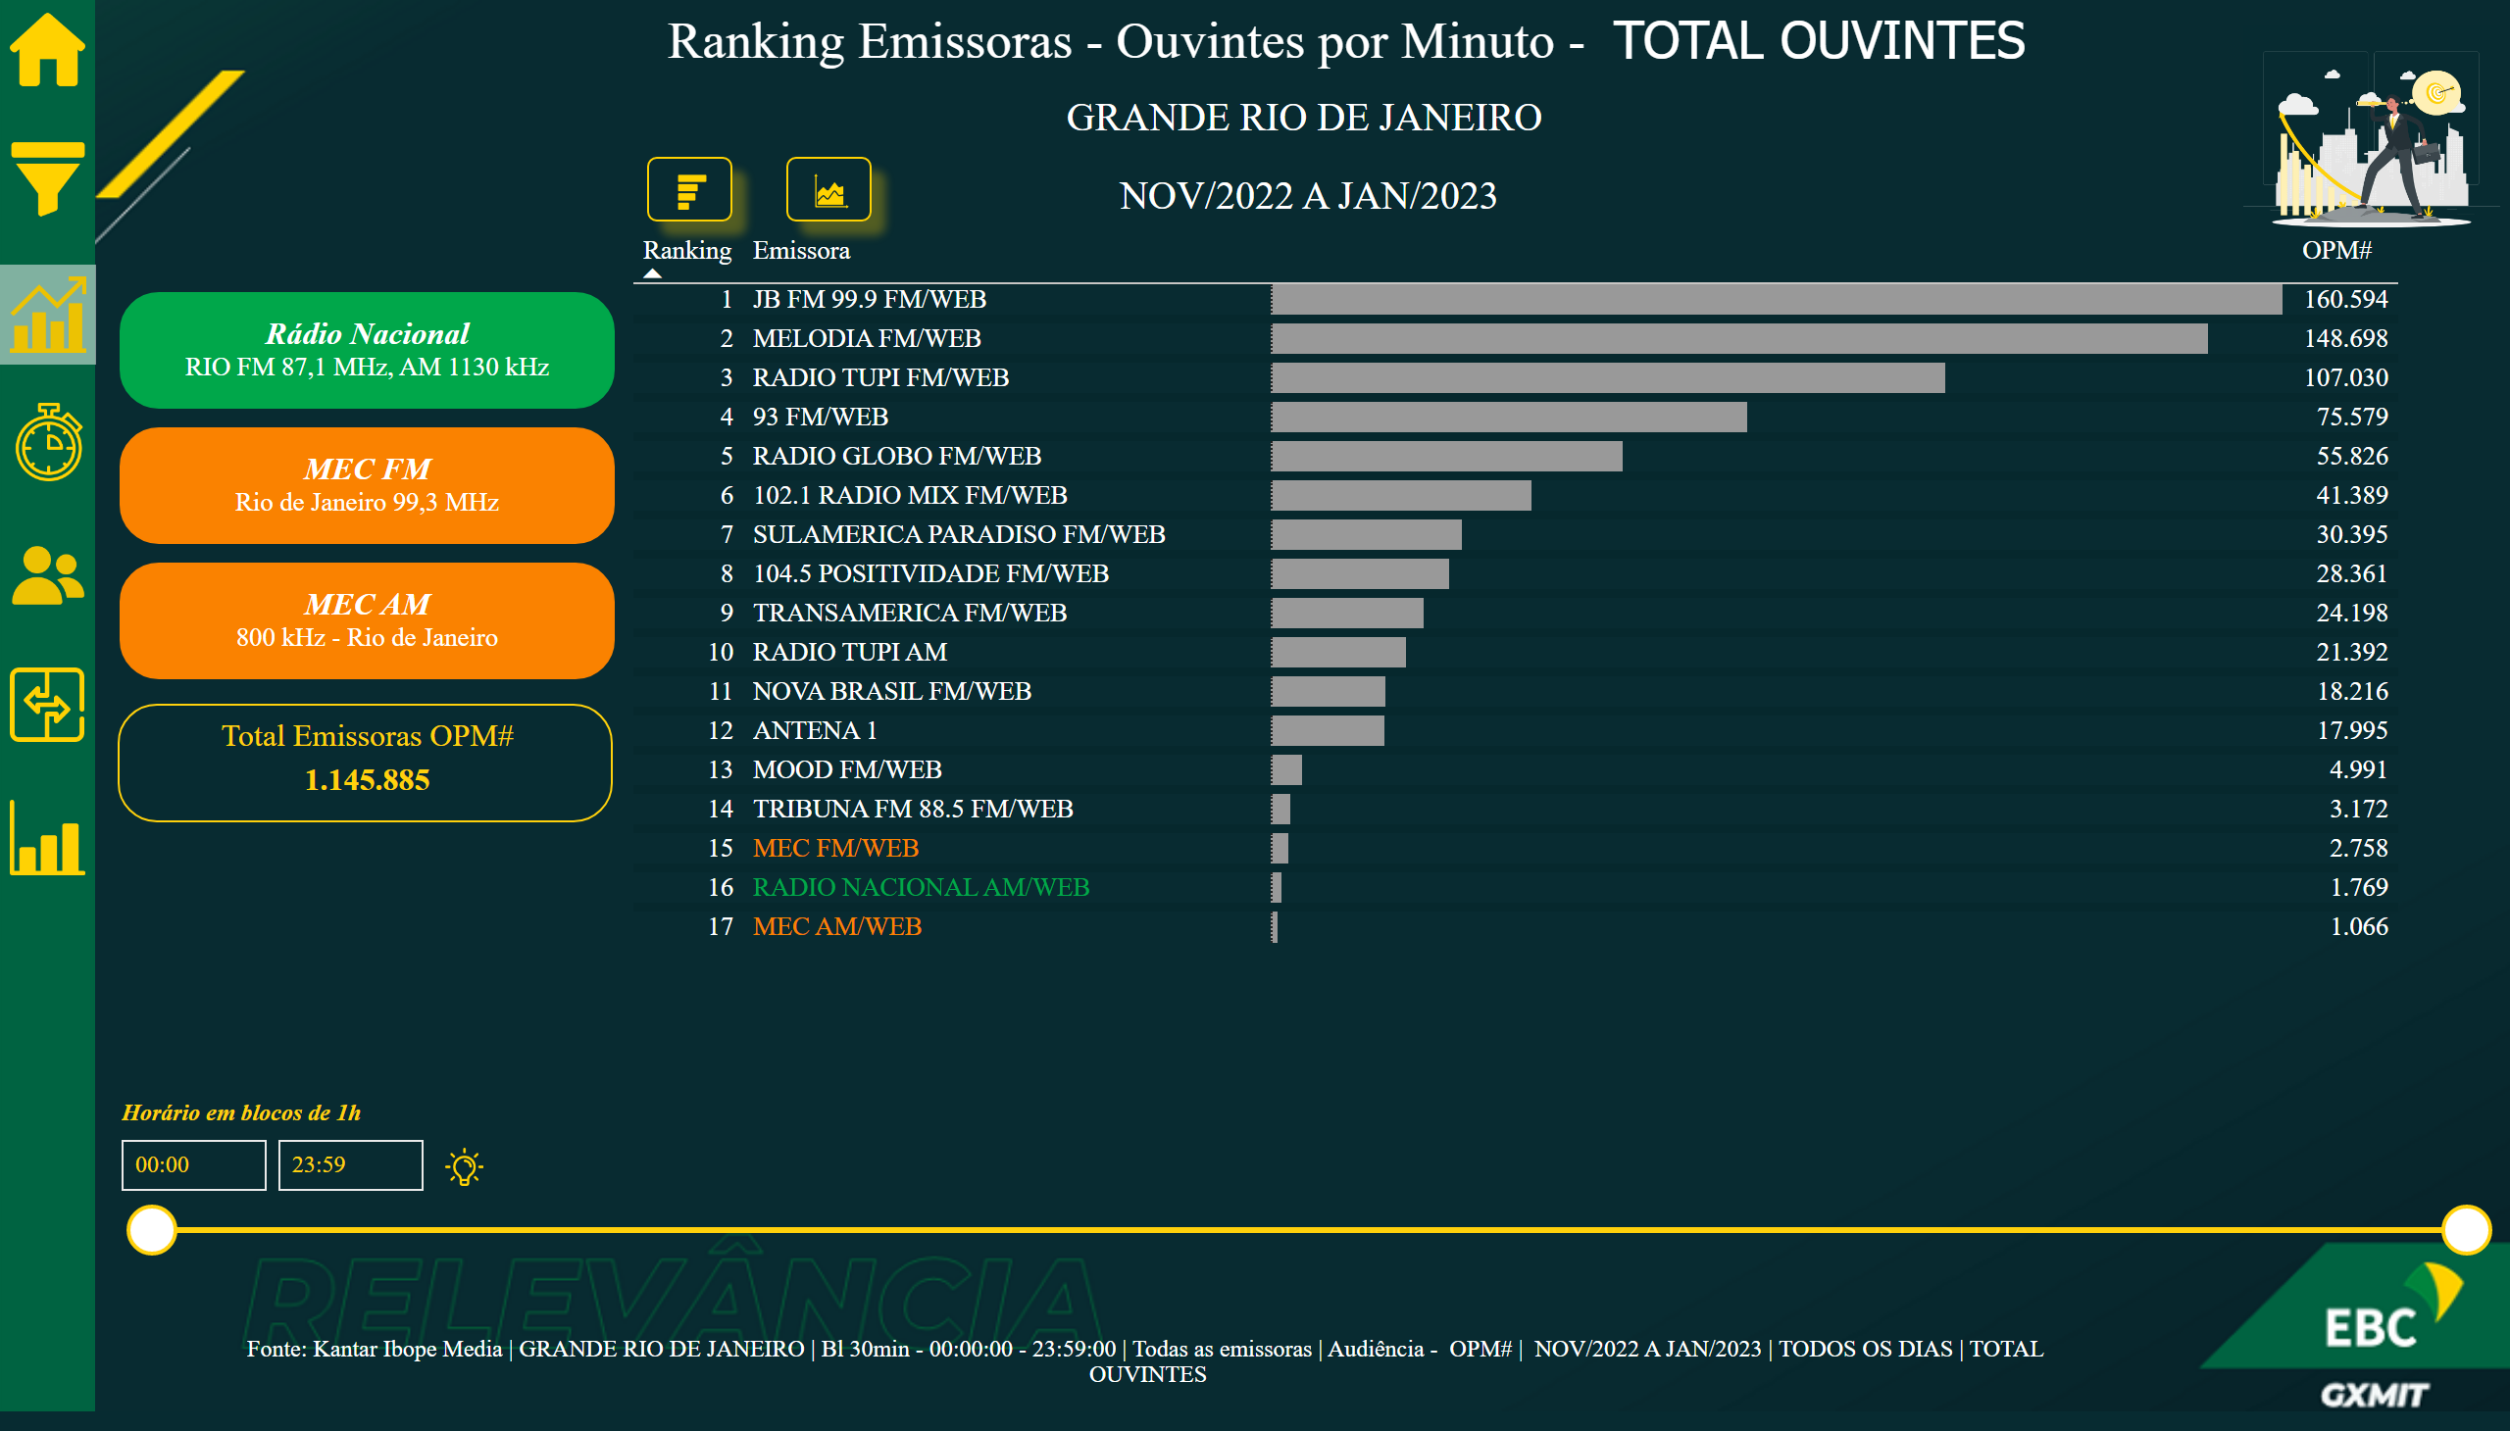
01_RJ
Notes:
Tb_bar
No alt text provided
image
No alt text provided
Icon_Dica
No alt text provided
image
No alt text provided
image
No alt text provided
card
No alt text provided
card
No alt text provided
card
No alt text provided
textbox
No alt text provided
shape
No alt text provided
actionButton
No alt text provided
actionButton
No alt text provided
shape
No alt text provided
actionButton
No alt text provided
slicer
No alt text provided
slicer
No alt text provided
slicer
No alt text provided
slicer
No alt text provided
tableEx
No alt text provided
clusteredBarChart
No alt text provided
shape
No alt text provided
image
No alt text provided
image
No alt text provided
image
No alt text provided
image
No alt text provided
image
No alt text provided
image
No alt text provided
image
No alt text provided
card
No alt text provided
advanceCardE03760C5AB684758B56AA29F9E6C257B
No alt text provided
textbox
No alt text provided
card
No alt text provided
card
No alt text provided
Im_Rank
No alt text provided
Im_Eixo
No alt text provided
Total Emissoras OPM#
No alt text provided
shape
No alt text provided
Icon_TMED
No alt text provided
Icon_Evolucao
No alt text provided
Icon_Comparativo
No alt text provided
Icon_Menu
No alt text provided
Icon_Ranking
No alt text provided
Icon_Perfil
No alt text provided
Icon_Home
No alt text provided
actionButton
No alt text provided
textbox
No alt text provided
actionButton
No alt text provided
textbox
No alt text provided
actionButton
No alt text provided
textbox
No alt text provided
Horário em blocos de 1h
No alt text provided
Fonte
No alt text provided
shape
No alt text provided
advanceCardE03760C5AB684758B56AA29F9E6C257B
No alt text provided
textbox
No alt text provided
card
No alt text provided
card
No alt text provided
clusteredBarChart
No alt text provided

Slide 4
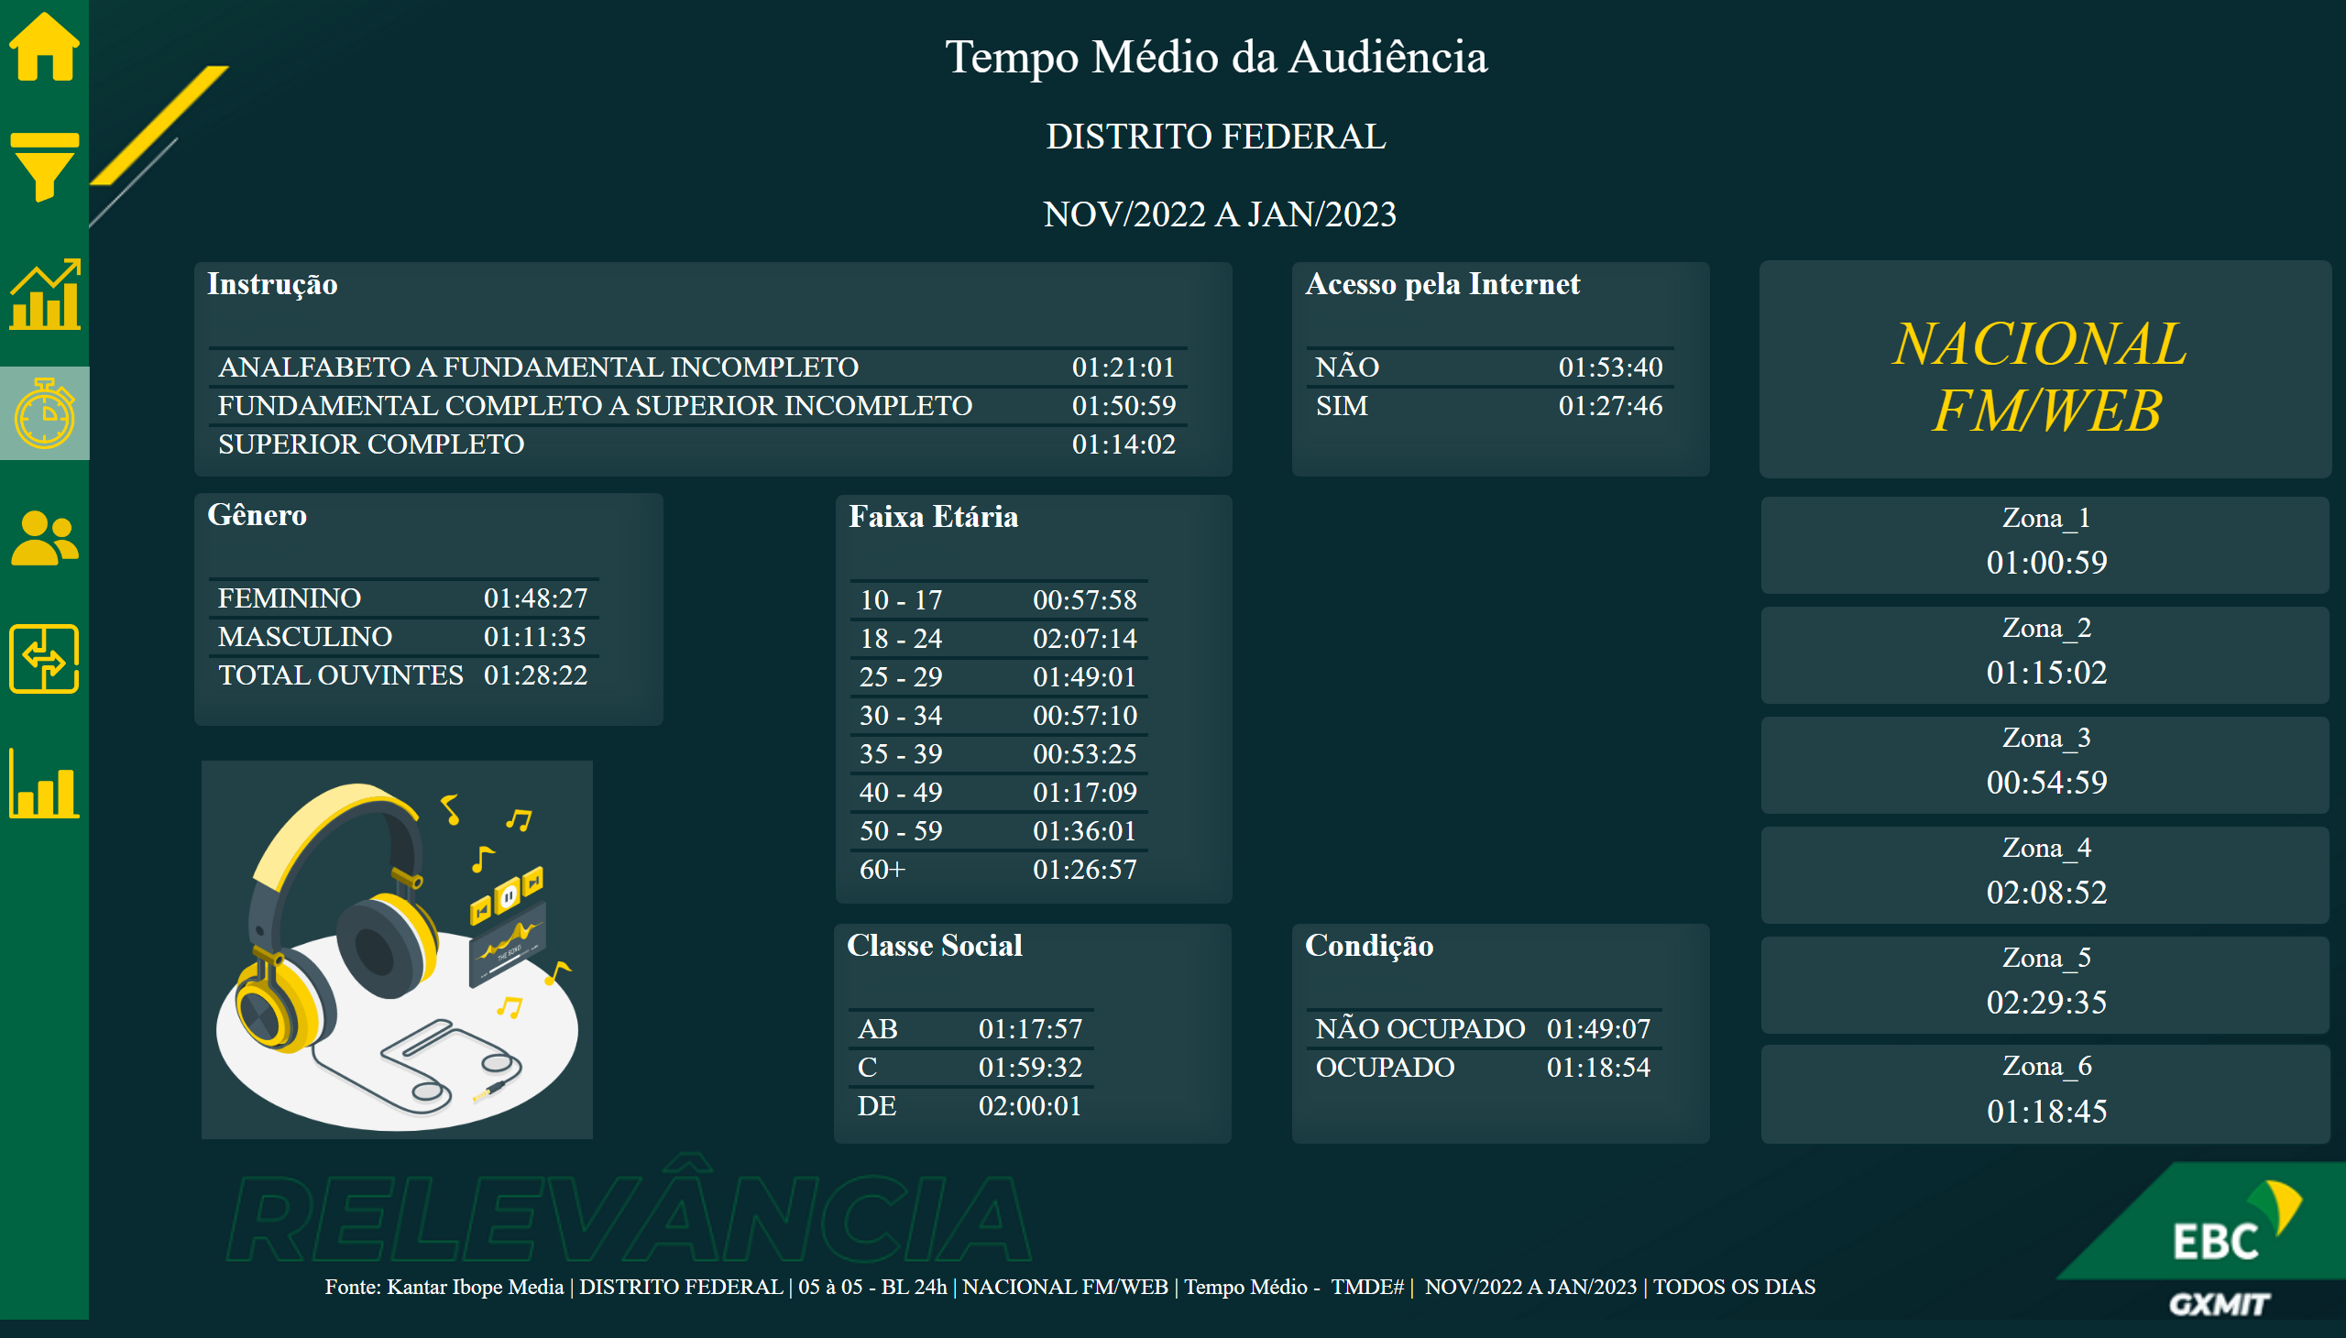
02_DF
Notes:
image
No alt text provided
image
No alt text provided
image
No alt text provided
image
No alt text provided
image
No alt text provided
image
No alt text provided
image
No alt text provided
shape
No alt text provided
card
No alt text provided
card
No alt text provided
slicer
No alt text provided
slicer
No alt text provided
slicer
No alt text provided
slicer
No alt text provided
actionButton
No alt text provided
shape
No alt text provided
actionButton
No alt text provided
actionButton
No alt text provided
shape
No alt text provided
textbox
No alt text provided
textbox
No alt text provided
card
No alt text provided
card
No alt text provided
card
No alt text provided
tableEx
No alt text provided
tableEx
No alt text provided
tableEx
No alt text provided
tableEx
No alt text provided
tableEx
No alt text provided
tableEx
No alt text provided
card
No alt text provided
card
No alt text provided
card
No alt text provided
card
No alt text provided
card
No alt text provided
card
No alt text provided
card
No alt text provided
clusteredBarChart
No alt text provided
Icon_Home
No alt text provided
Icon_Perfil
No alt text provided
Icon_Ranking
No alt text provided
Icon_Menu
No alt text provided
Icon_Comparativo
No alt text provided
Icon_Evolucao
No alt text provided
Icon_TMED
No alt text provided
shape
No alt text provided
textbox
No alt text provided
card
No alt text provided
card
No alt text provided
Faixa Etária
No alt text provided
Classe Social
No alt text provided
Gênero
No alt text provided
Acesso pela Internet
No alt text provided
Instrução
No alt text provided
Condição
No alt text provided
Card_Emissora
No alt text provided
Zona_1
No alt text provided
Zona_2
No alt text provided
Zona_3
No alt text provided
Zona_4
No alt text provided
Zona_5
No alt text provided
Zona_6
No alt text provided
Head_Gif
No alt text provided
Fonte
No alt text provided
image
No alt text provided

Slide 5
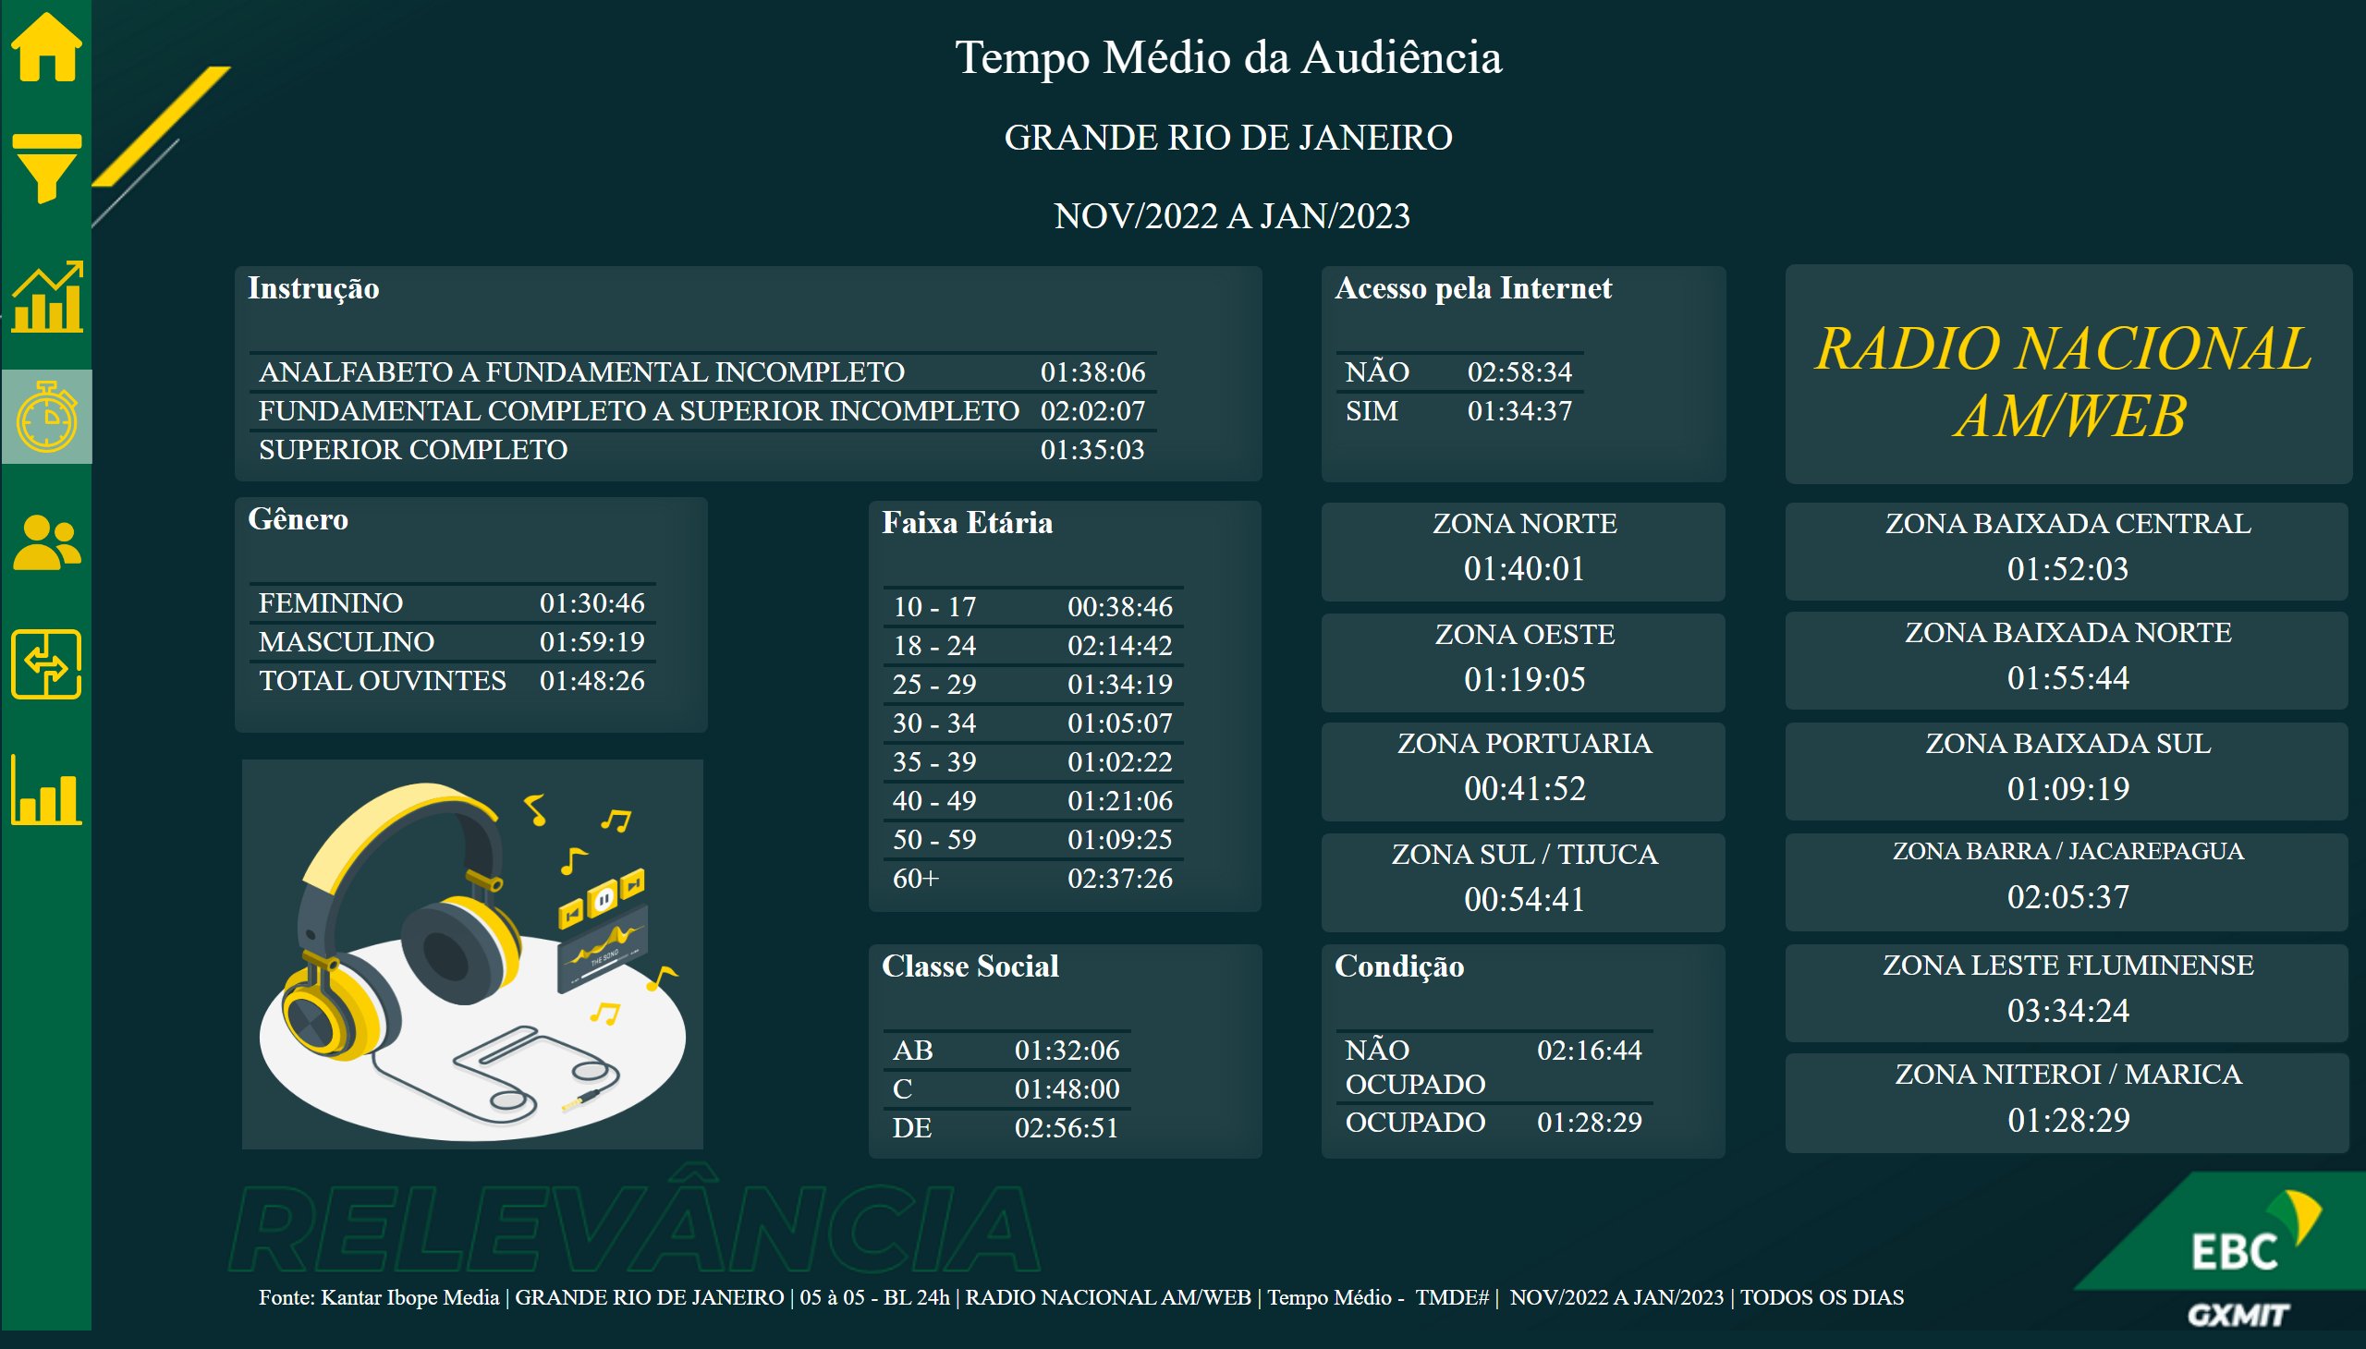
02_RJ
Notes:
image
No alt text provided
Head_Gif
No alt text provided
ZONA SUL / TIJUCA
No alt text provided
ZONA PORTUARIA
No alt text provided
ZONA OESTE
No alt text provided
ZONA NORTE
No alt text provided
ZONA NITEROI / MARICA
No alt text provided
ZONA LESTE FLUMINENSE
No alt text provided
ZONA BARRA / JACAREPAGUA
No alt text provided
ZONA BAIXADA SUL
No alt text provided
ZONA BAIXADA NORTE
No alt text provided
ZONA BAIXADA CENTRAL
No alt text provided
Card_Emissora
No alt text provided
Condição
No alt text provided
Instrução
No alt text provided
Acesso pela Internet
No alt text provided
Gênero
No alt text provided
Classe Social
No alt text provided
Faixa Etária
No alt text provided
Fonte
No alt text provided
card
No alt text provided
card
No alt text provided
textbox
No alt text provided
shape
No alt text provided
Icon_TMED
No alt text provided
Icon_Evolucao
No alt text provided
Icon_Comparativo
No alt text provided
Icon_Menu
No alt text provided
Icon_Ranking
No alt text provided
Icon_Perfil
No alt text provided
Icon_Home
No alt text provided
clusteredBarChart
No alt text provided
card
No alt text provided
card
No alt text provided
card
No alt text provided
card
No alt text provided
card
No alt text provided
card
No alt text provided
card
No alt text provided
card
No alt text provided
card
No alt text provided
card
No alt text provided
card
No alt text provided
tableEx
No alt text provided
tableEx
No alt text provided
tableEx
No alt text provided
tableEx
No alt text provided
tableEx
No alt text provided
tableEx
No alt text provided
card
No alt text provided
card
No alt text provided
card
No alt text provided
textbox
No alt text provided
textbox
No alt text provided
shape
No alt text provided
actionButton
No alt text provided
actionButton
No alt text provided
shape
No alt text provided
actionButton
No alt text provided
slicer
No alt text provided
slicer
No alt text provided
slicer
No alt text provided
slicer
No alt text provided
card
No alt text provided
card
No alt text provided
shape
No alt text provided
image
No alt text provided
image
No alt text provided
image
No alt text provided
image
No alt text provided
image
No alt text provided
image
No alt text provided
image
No alt text provided

Slide 6
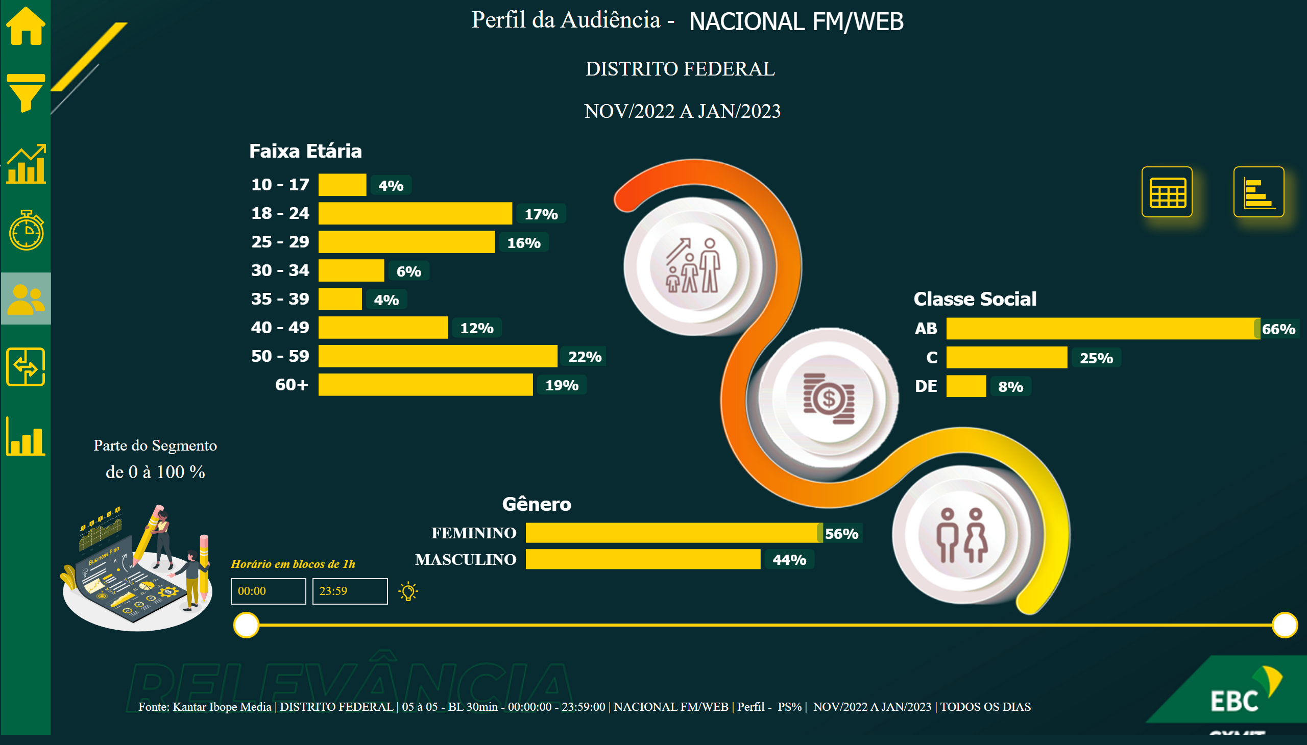
03_DF
Notes:
image
No alt text provided
Icon_Dica
No alt text provided
textbox
No alt text provided
Classe Social
No alt text provided
textbox
No alt text provided
Faixa Etária
No alt text provided
shape
No alt text provided
textbox
No alt text provided
Gênero
No alt text provided
image
No alt text provided
textbox
No alt text provided
tableEx
No alt text provided
textbox
No alt text provided
tableEx
No alt text provided
shape
No alt text provided
textbox
No alt text provided
tableEx
No alt text provided
image
No alt text provided
image
No alt text provided
image
No alt text provided
Fonte_2
No alt text provided
textbox
No alt text provided
advanceCardE03760C5AB684758B56AA29F9E6C257B
No alt text provided
card
No alt text provided
card
No alt text provided
Parte do Segmento
No alt text provided
Gif
No alt text provided
shape
No alt text provided
Icon_TMED
No alt text provided
Icon_Evolucao
No alt text provided
Icon_Comparativo
No alt text provided
Icon_Menu
No alt text provided
Icon_Ranking
No alt text provided
Icon_Perfil
No alt text provided
Icon_Home
No alt text provided
clusteredBarChart
No alt text provided
textbox
No alt text provided
tableEx
No alt text provided
textbox
No alt text provided
tableEx
No alt text provided
shape
No alt text provided
image
No alt text provided
textbox
No alt text provided
tableEx
No alt text provided
card
No alt text provided
card
No alt text provided
card
No alt text provided
textbox
No alt text provided
advanceCardE03760C5AB684758B56AA29F9E6C257B
No alt text provided
textbox
No alt text provided
shape
No alt text provided
actionButton
No alt text provided
actionButton
No alt text provided
shape
No alt text provided
actionButton
No alt text provided
slicer
No alt text provided
slicer
No alt text provided
slicer
No alt text provided
slicer
No alt text provided
card
No alt text provided
card
No alt text provided
shape
No alt text provided
image
No alt text provided
image
No alt text provided
image
No alt text provided
image
No alt text provided
image
No alt text provided
image
No alt text provided
image
No alt text provided
Horário em blocos de 1h
No alt text provided

Slide 7
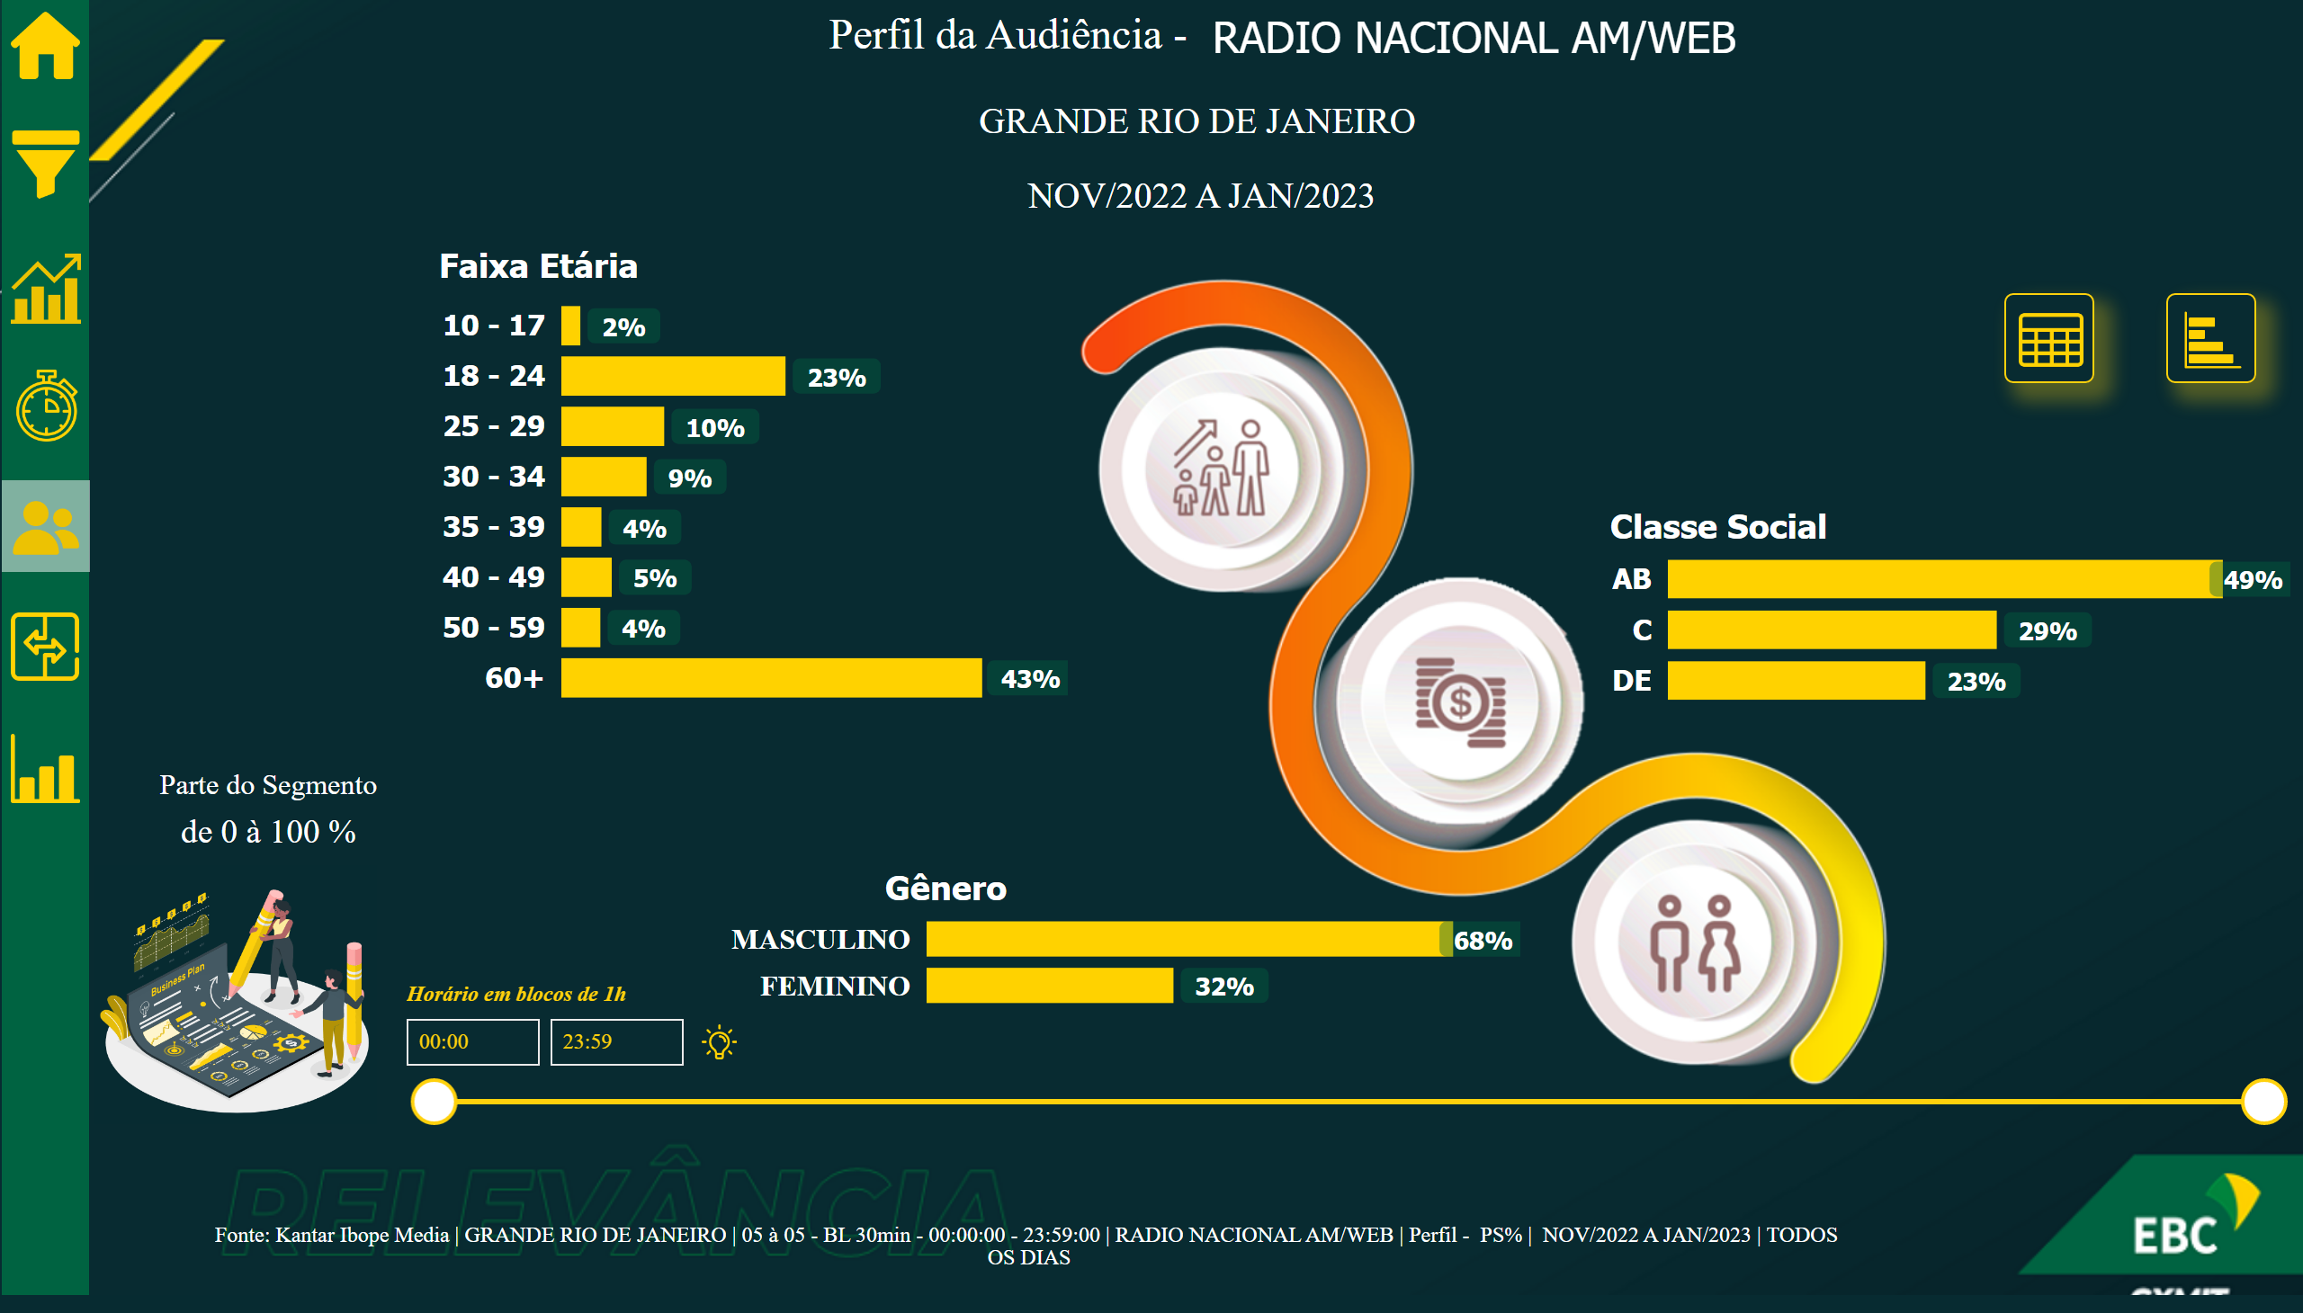
03_RJ
Notes:
image
No alt text provided
Icon_Dica
No alt text provided
image
No alt text provided
image
No alt text provided
textbox
No alt text provided
tableEx
No alt text provided
textbox
No alt text provided
tableEx
No alt text provided
shape
No alt text provided
textbox
No alt text provided
tableEx
No alt text provided
image
No alt text provided
textbox
No alt text provided
Classe Social
No alt text provided
textbox
No alt text provided
Faixa Etária
No alt text provided
shape
No alt text provided
textbox
No alt text provided
Gênero
No alt text provided
image
No alt text provided
textbox
No alt text provided
advanceCardE03760C5AB684758B56AA29F9E6C257B
No alt text provided
card
No alt text provided
card
No alt text provided
Fonte_2
No alt text provided
Parte do Segmento
No alt text provided
Gif
No alt text provided
shape
No alt text provided
Icon_TMED
No alt text provided
Icon_Evolucao
No alt text provided
Icon_Comparativo
No alt text provided
Icon_Menu
No alt text provided
Icon_Ranking
No alt text provided
Icon_Perfil
No alt text provided
Icon_Home
No alt text provided
clusteredBarChart
No alt text provided
textbox
No alt text provided
tableEx
No alt text provided
textbox
No alt text provided
tableEx
No alt text provided
shape
No alt text provided
textbox
No alt text provided
tableEx
No alt text provided
image
No alt text provided
card
No alt text provided
textbox
No alt text provided
advanceCardE03760C5AB684758B56AA29F9E6C257B
No alt text provided
card
No alt text provided
card
No alt text provided
textbox
No alt text provided
shape
No alt text provided
actionButton
No alt text provided
actionButton
No alt text provided
shape
No alt text provided
actionButton
No alt text provided
slicer
No alt text provided
slicer
No alt text provided
slicer
No alt text provided
slicer
No alt text provided
card
No alt text provided
card
No alt text provided
shape
No alt text provided
image
No alt text provided
image
No alt text provided
image
No alt text provided
image
No alt text provided
image
No alt text provided
image
No alt text provided
image
No alt text provided
Horário em blocos de 1h
No alt text provided

Slide 8
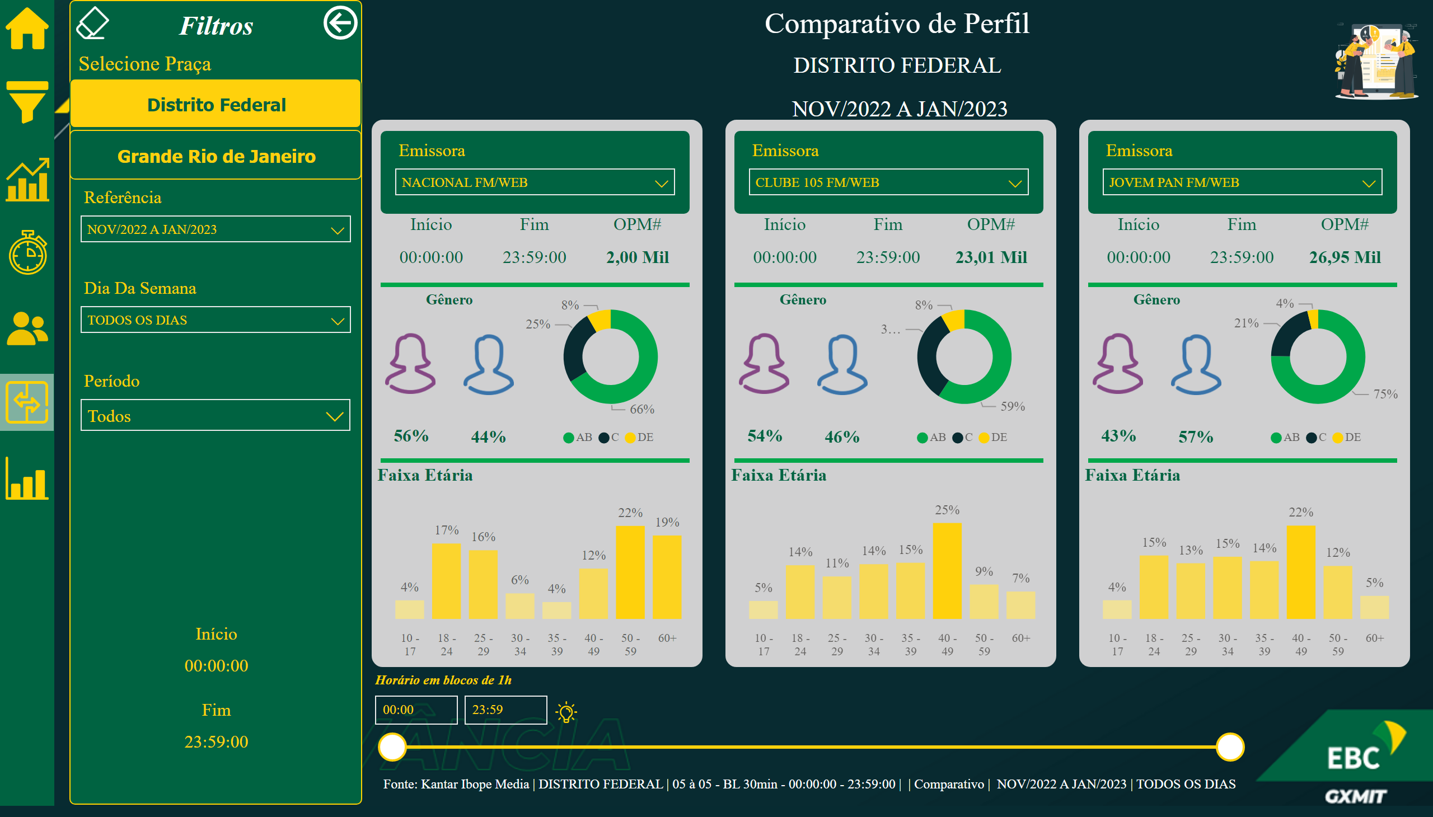
04_DF
Notes:
Borracha
No alt text provided
Icon_Dica
No alt text provided
Horário em blocos de 1h
No alt text provided
clusteredColumnChart
No alt text provided
donutChart
No alt text provided
card
No alt text provided
card
No alt text provided
card
No alt text provided
slicer
No alt text provided
card
No alt text provided
image
No alt text provided
textbox
No alt text provided
card
No alt text provided
image
No alt text provided
shape
No alt text provided
shape
No alt text provided
shape
No alt text provided
clusteredColumnChart
No alt text provided
donutChart
No alt text provided
card
No alt text provided
card
No alt text provided
card
No alt text provided
slicer
No alt text provided
card
No alt text provided
image
No alt text provided
textbox
No alt text provided
card
No alt text provided
image
No alt text provided
shape
No alt text provided
shape
No alt text provided
shape
No alt text provided
clusteredColumnChart
No alt text provided
donutChart
No alt text provided
card
No alt text provided
card
No alt text provided
card
No alt text provided
slicer
No alt text provided
card
No alt text provided
image
No alt text provided
textbox
No alt text provided
card
No alt text provided
image
No alt text provided
shape
No alt text provided
shape
No alt text provided
shape
No alt text provided
card
No alt text provided
shape
No alt text provided
image
No alt text provided
image
No alt text provided
image
No alt text provided
image
No alt text provided
image
No alt text provided
image
No alt text provided
image
No alt text provided
card
No alt text provided
card
No alt text provided
textbox
No alt text provided
textbox
No alt text provided
shape
No alt text provided
Botão_RJ
No alt text provided
Botão_DF
No alt text provided
Selecione Praça
No alt text provided
Botão_Voltar
No alt text provided
Seg_Período
No alt text provided
Período
No alt text provided
Seg_D.Semana
No alt text provided
Fim
No alt text provided
Início
No alt text provided
Faixa Etária
No alt text provided
donutChart
No alt text provided
OPM#
No alt text provided
Fim
No alt text provided
Início
No alt text provided
Seg_Publico
No alt text provided
card
No alt text provided
Feminino
No alt text provided
textbox
No alt text provided
card
No alt text provided
Masculino
No alt text provided
Linha
No alt text provided
Linha
No alt text provided
shape
No alt text provided
Faixa Etária
No alt text provided
donutChart
No alt text provided
OPM#
No alt text provided
Fim
No alt text provided
Início
No alt text provided
Seg_Publico
No alt text provided
card
No alt text provided
Feminino
No alt text provided
textbox
No alt text provided
card
No alt text provided
Masculino
No alt text provided
Linha
No alt text provided
Linha
No alt text provided
shape
No alt text provided
Faixa Etária
No alt text provided
donutChart
No alt text provided
OPM#
No alt text provided
Fim
No alt text provided
Início
No alt text provided
Seg_Publico
No alt text provided
card
No alt text provided
Feminino
No alt text provided
textbox
No alt text provided
card
No alt text provided
Masculino
No alt text provided
Linha
No alt text provided
Linha
No alt text provided
shape
No alt text provided
Fonte
No alt text provided
shape
No alt text provided
Icon_TMED
No alt text provided
Icon_Evolucao
No alt text provided
Icon_Menu
No alt text provided
Icon_Ranking
No alt text provided
Icon_Perfil
No alt text provided
Icon_Comparativo
No alt text provided
Icon_Home
No alt text provided
card
No alt text provided
card
No alt text provided
textbox
No alt text provided
clusteredBarChart
No alt text provided

Slide 9
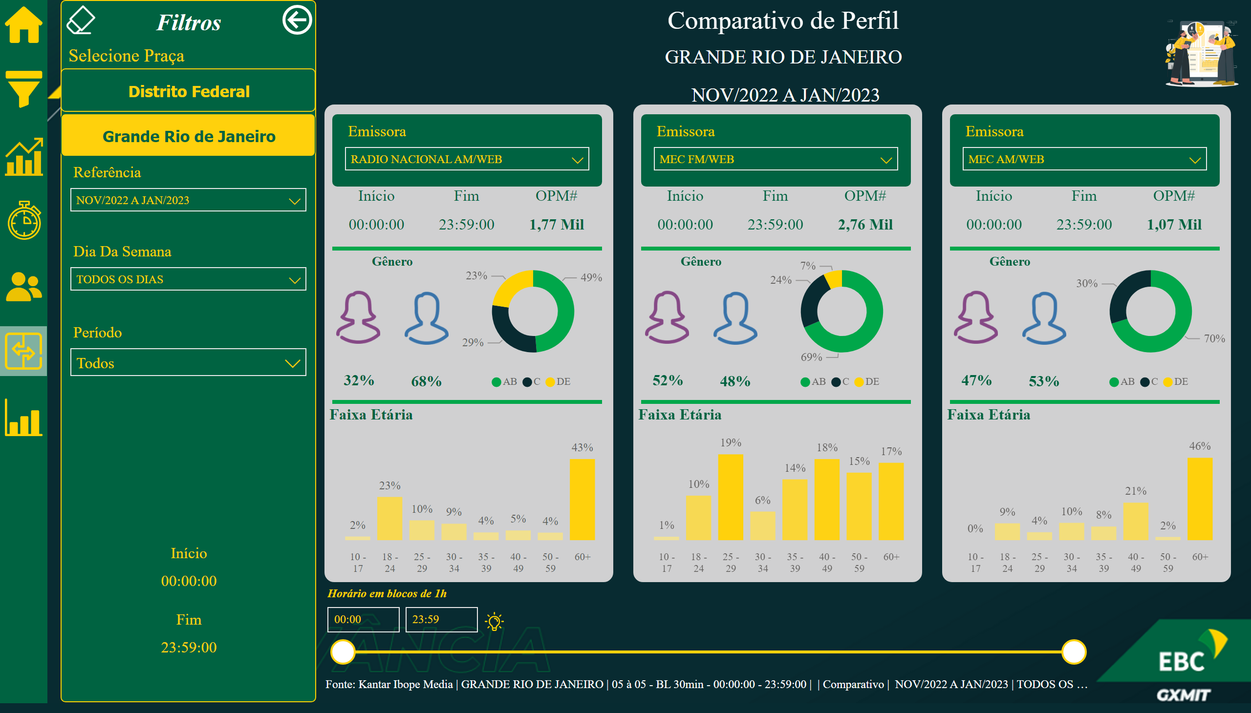
04_RJ
Notes:
Horário em blocos de 1h
No alt text provided
Icon_Dica
No alt text provided
Borracha
No alt text provided
clusteredColumnChart
No alt text provided
donutChart
No alt text provided
card
No alt text provided
card
No alt text provided
card
No alt text provided
slicer
No alt text provided
card
No alt text provided
image
No alt text provided
textbox
No alt text provided
card
No alt text provided
image
No alt text provided
shape
No alt text provided
shape
No alt text provided
shape
No alt text provided
clusteredColumnChart
No alt text provided
donutChart
No alt text provided
card
No alt text provided
card
No alt text provided
card
No alt text provided
slicer
No alt text provided
card
No alt text provided
image
No alt text provided
textbox
No alt text provided
card
No alt text provided
image
No alt text provided
shape
No alt text provided
shape
No alt text provided
shape
No alt text provided
clusteredColumnChart
No alt text provided
donutChart
No alt text provided
card
No alt text provided
card
No alt text provided
card
No alt text provided
slicer
No alt text provided
card
No alt text provided
image
No alt text provided
textbox
No alt text provided
card
No alt text provided
image
No alt text provided
shape
No alt text provided
shape
No alt text provided
shape
No alt text provided
card
No alt text provided
shape
No alt text provided
image
No alt text provided
image
No alt text provided
image
No alt text provided
image
No alt text provided
image
No alt text provided
image
No alt text provided
image
No alt text provided
card
No alt text provided
card
No alt text provided
textbox
No alt text provided
textbox
No alt text provided
shape
No alt text provided
Botão_RJ
No alt text provided
Botão_DF
No alt text provided
Selecione Praça
No alt text provided
Botão_Voltar
No alt text provided
Seg_Período
No alt text provided
Período
No alt text provided
Seg_D.Semana
No alt text provided
Fim
No alt text provided
Início
No alt text provided
Faixa Etária
No alt text provided
donutChart
No alt text provided
OPM#
No alt text provided
Fim
No alt text provided
Início
No alt text provided
Seg_Publico
No alt text provided
card
No alt text provided
Feminino
No alt text provided
textbox
No alt text provided
card
No alt text provided
Masculino
No alt text provided
Linha
No alt text provided
Linha
No alt text provided
shape
No alt text provided
Faixa Etária
No alt text provided
donutChart
No alt text provided
OPM#
No alt text provided
Fim
No alt text provided
Início
No alt text provided
Seg_Publico
No alt text provided
card
No alt text provided
Feminino
No alt text provided
textbox
No alt text provided
card
No alt text provided
Masculino
No alt text provided
Linha
No alt text provided
Linha
No alt text provided
shape
No alt text provided
Faixa Etária
No alt text provided
donutChart
No alt text provided
OPM#
No alt text provided
Fim
No alt text provided
Início
No alt text provided
Seg_Publico
No alt text provided
card
No alt text provided
Feminino
No alt text provided
textbox
No alt text provided
card
No alt text provided
Masculino
No alt text provided
Linha
No alt text provided
Linha
No alt text provided
shape
No alt text provided
Fonte
No alt text provided
shape
No alt text provided
Icon_TMED
No alt text provided
Icon_Evolucao
No alt text provided
Icon_Menu
No alt text provided
Icon_Ranking
No alt text provided
Icon_Perfil
No alt text provided
Icon_Comparativo
No alt text provided
Icon_Home
No alt text provided
card
No alt text provided
card
No alt text provided
textbox
No alt text provided
clusteredBarChart
No alt text provided

Slide 10
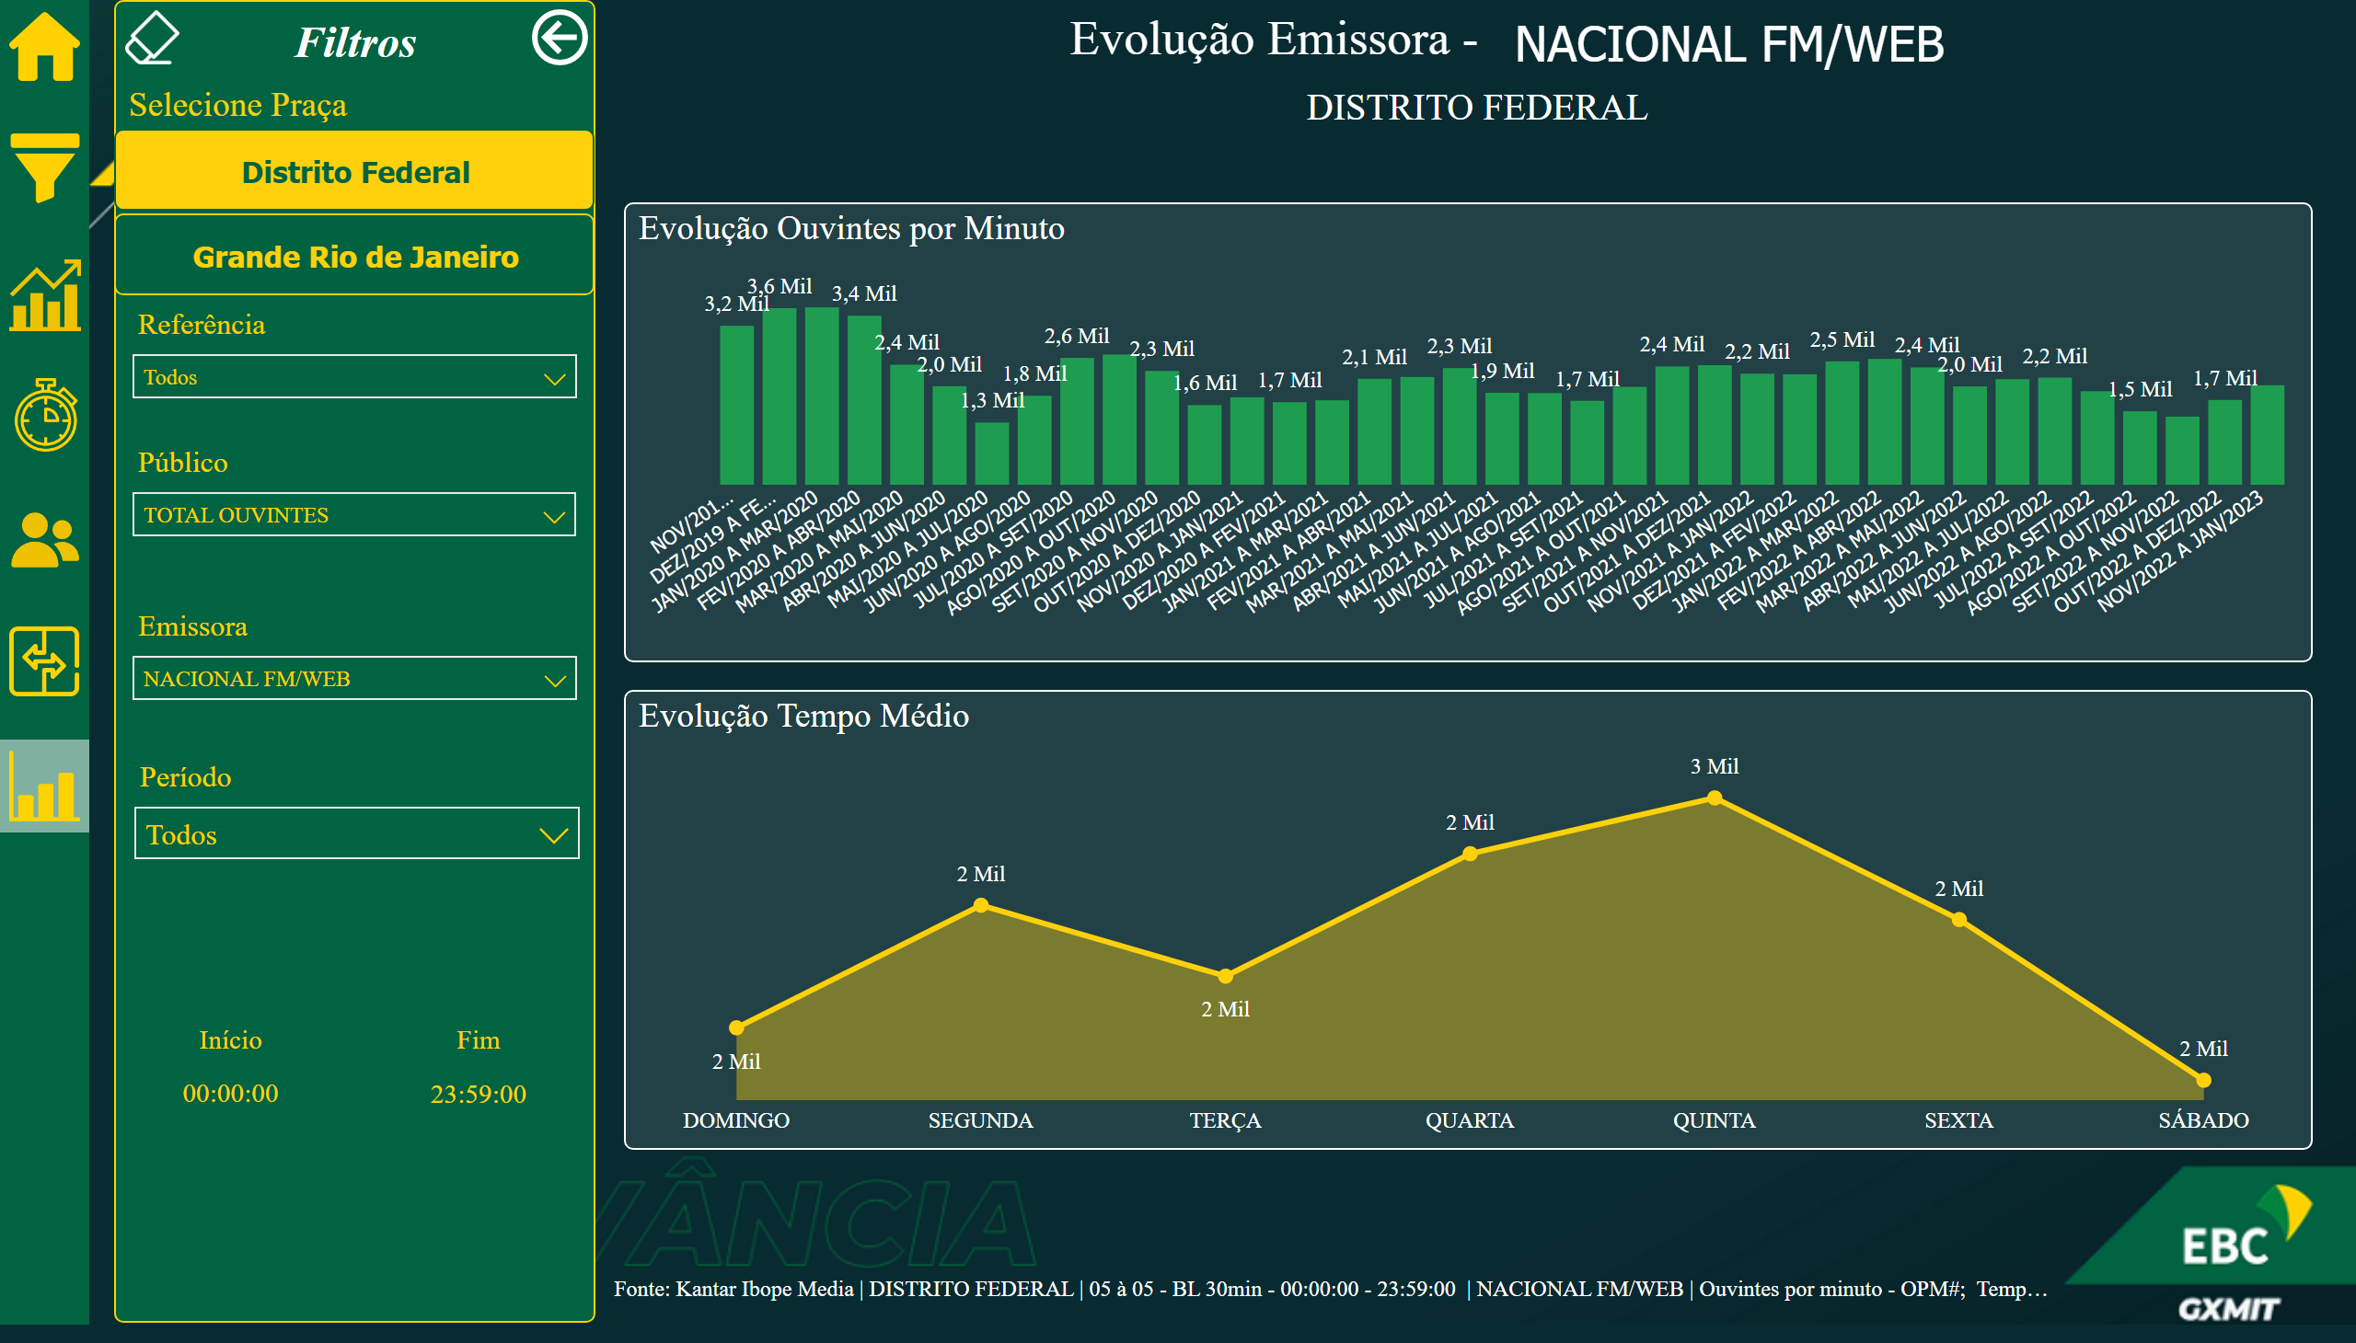
05_DF
Notes:
slicer
No alt text provided
image
No alt text provided
areaChart
No alt text provided
areaChart
No alt text provided
areaChart
No alt text provided
Borracha
No alt text provided
actionButton
No alt text provided
actionButton
No alt text provided
actionButton
No alt text provided
actionButton
No alt text provided
areaChart
No alt text provided
clusteredColumnChart
No alt text provided
card
No alt text provided
shape
No alt text provided
image
No alt text provided
image
No alt text provided
image
No alt text provided
image
No alt text provided
image
No alt text provided
image
No alt text provided
image
No alt text provided
advanceCardE03760C5AB684758B56AA29F9E6C257B
No alt text provided
card
No alt text provided
textbox
No alt text provided
Evolução Tempo Médio
No alt text provided
Evolução Ouvintes por Minuto
No alt text provided
Início
No alt text provided
Fim
No alt text provided
Dic_Zona
No alt text provided
textbox
No alt text provided
shape
No alt text provided
Seg_Período
No alt text provided
Seg_Publico
No alt text provided
Seg_Emissora
No alt text provided
Botão_RJ
No alt text provided
Botão_DF
No alt text provided
Selecione Praça
No alt text provided
Botão_Voltar
No alt text provided
Período
No alt text provided
Fonte
No alt text provided
shape
No alt text provided
Icon_TMED
No alt text provided
Icon_Evolucao
No alt text provided
Icon_Menu
No alt text provided
Icon_Ranking
No alt text provided
Icon_Perfil
No alt text provided
Icon_Comparativo
No alt text provided
Icon_Home
No alt text provided
Card_Emissora
No alt text provided
card
No alt text provided
textbox
No alt text provided

Slide 11
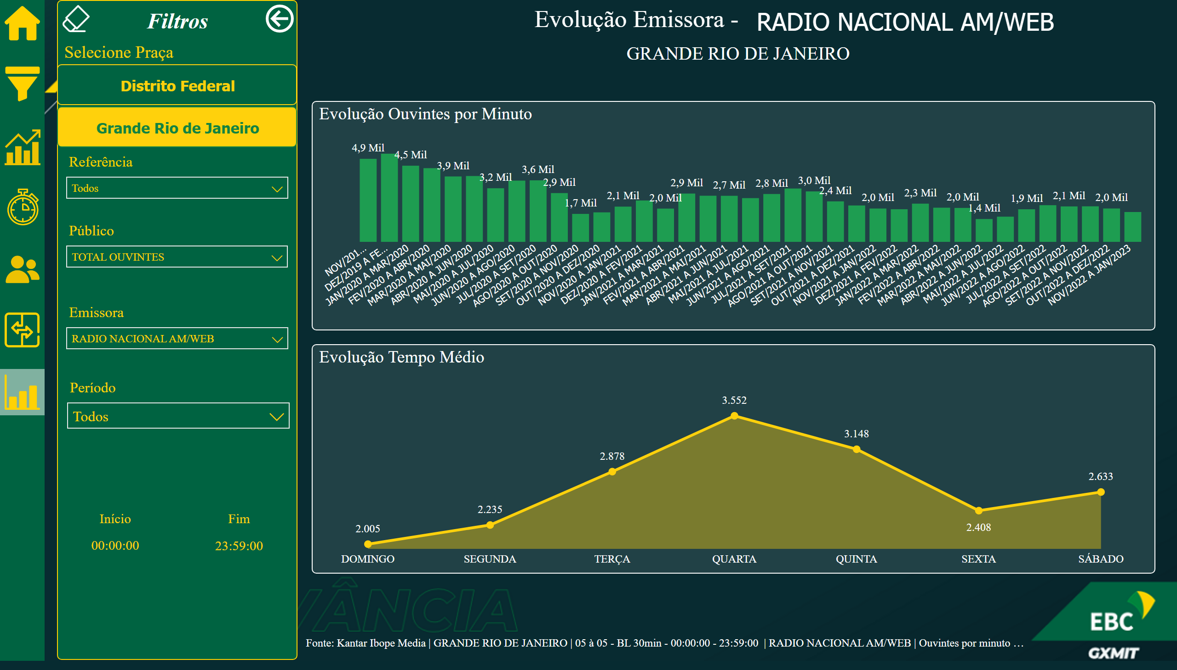
05_RJ
Notes:
slicer
No alt text provided
image
No alt text provided
areaChart
No alt text provided
areaChart
No alt text provided
areaChart
No alt text provided
Borracha
No alt text provided
actionButton
No alt text provided
actionButton
No alt text provided
actionButton
No alt text provided
actionButton
No alt text provided
areaChart
No alt text provided
clusteredColumnChart
No alt text provided
card
No alt text provided
shape
No alt text provided
image
No alt text provided
image
No alt text provided
image
No alt text provided
image
No alt text provided
image
No alt text provided
image
No alt text provided
image
No alt text provided
advanceCardE03760C5AB684758B56AA29F9E6C257B
No alt text provided
card
No alt text provided
textbox
No alt text provided
Evolução Tempo Médio
No alt text provided
Evolução Ouvintes por Minuto
No alt text provided
Início
No alt text provided
Fim
No alt text provided
Dic_Zona
No alt text provided
textbox
No alt text provided
shape
No alt text provided
Seg_Período
No alt text provided
Seg_Publico
No alt text provided
Seg_Emissora
No alt text provided
Botão_RJ
No alt text provided
Botão_DF
No alt text provided
Selecione Praça
No alt text provided
Botão_Voltar
No alt text provided
Período
No alt text provided
Fonte
No alt text provided
shape
No alt text provided
Icon_TMED
No alt text provided
Icon_Evolucao
No alt text provided
Icon_Menu
No alt text provided
Icon_Ranking
No alt text provided
Icon_Perfil
No alt text provided
Icon_Comparativo
No alt text provided
Icon_Home
No alt text provided
Card_Emissora
No alt text provided
card
No alt text provided
textbox
No alt text provided

Slide 12
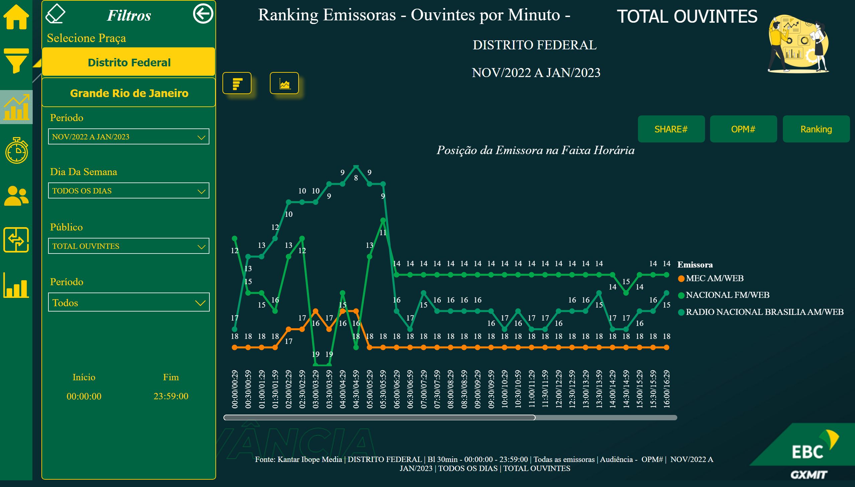
06_DF
Notes:
Bt_Pos_Rank
No alt text provided
Bt_SHR#
No alt text provided
Bt_OPM#
No alt text provided
Borracha
No alt text provided
Im_Rank
No alt text provided
Im_Eixo
No alt text provided
textbox
No alt text provided
shape
No alt text provided
Dic_Zona
No alt text provided
Botão_RJ
No alt text provided
Botão_DF
No alt text provided
Selecione Praça
No alt text provided
Botão_Voltar
No alt text provided
Seg_Publico
No alt text provided
Seg_Período
No alt text provided
Período
No alt text provided
Seg_D.Semana
No alt text provided
Fim
No alt text provided
Início
No alt text provided
image
No alt text provided
shape
No alt text provided
Icon_TMED
No alt text provided
Icon_Evolucao
No alt text provided
Icon_Comparativo
No alt text provided
Icon_Menu
No alt text provided
Icon_Ranking
No alt text provided
Icon_Perfil
No alt text provided
Icon_Home
No alt text provided
Fonte_2
No alt text provided
card
No alt text provided
card
No alt text provided
advanceCardE03760C5AB684758B56AA29F9E6C257B
No alt text provided
textbox
No alt text provided
lineChart
No alt text provided
lineChart
No alt text provided
lineChart
No alt text provided
slicer
No alt text provided
image
No alt text provided
image
No alt text provided
shape
No alt text provided
image
No alt text provided
image
No alt text provided
image
No alt text provided
image
No alt text provided
image
No alt text provided
image
No alt text provided
image
No alt text provided
card
No alt text provided
textbox
No alt text provided
advanceCardE03760C5AB684758B56AA29F9E6C257B
No alt text provided
image
No alt text provided
card
No alt text provided
card
No alt text provided
slicer
No alt text provided
Posição da Emissora na Faixa Horária
No alt text provided
actionButton
No alt text provided
actionButton
No alt text provided
actionButton
No alt text provided

Slide 13
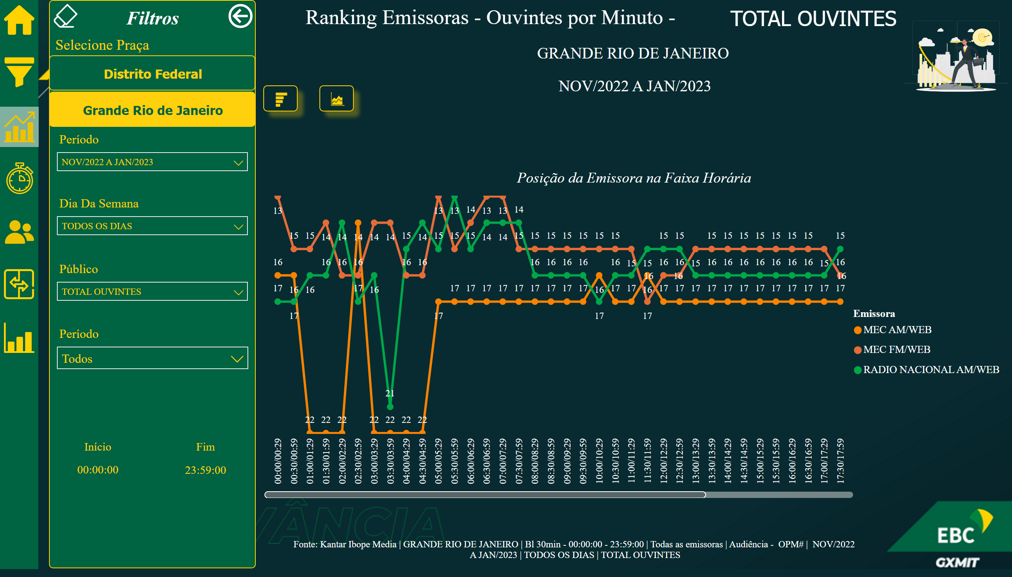
06_RJ
Notes:
actionButton
No alt text provided
actionButton
No alt text provided
actionButton
No alt text provided
Borracha
No alt text provided
Início
No alt text provided
Fim
No alt text provided
Dic_Zona
No alt text provided
textbox
No alt text provided
shape
No alt text provided
Botão_RJ
No alt text provided
Botão_DF
No alt text provided
Selecione Praça
No alt text provided
Botão_Voltar
No alt text provided
Seg_Publico
No alt text provided
Seg_Período
No alt text provided
Período
No alt text provided
Seg_D.Semana
No alt text provided
Im_Rank
No alt text provided
Im_Eixo
No alt text provided
Posição da Emissora na Faixa Horária
No alt text provided
shape
No alt text provided
Icon_TMED
No alt text provided
Icon_Evolucao
No alt text provided
Icon_Comparativo
No alt text provided
Icon_Menu
No alt text provided
Icon_Ranking
No alt text provided
Icon_Perfil
No alt text provided
Icon_Home
No alt text provided
Fonte_2
No alt text provided
card
No alt text provided
card
No alt text provided
advanceCardE03760C5AB684758B56AA29F9E6C257B
No alt text provided
textbox
No alt text provided
lineChart
No alt text provided
lineChart
No alt text provided
lineChart
No alt text provided
image
No alt text provided
image
No alt text provided
shape
No alt text provided
image
No alt text provided
image
No alt text provided
image
No alt text provided
image
No alt text provided
image
No alt text provided
image
No alt text provided
image
No alt text provided
card
No alt text provided
card
No alt text provided
card
No alt text provided
textbox
No alt text provided
advanceCardE03760C5AB684758B56AA29F9E6C257B
No alt text provided
slicer
No alt text provided
slicer
No alt text provided
clusteredBarChart
No alt text provided
actionButton
No alt text provided
actionButton
No alt text provided
actionButton
No alt text provided

Slide 14
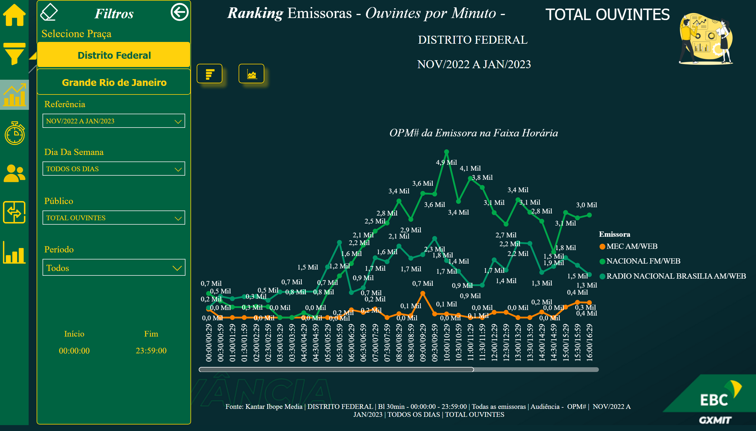
07_DF
Notes:
actionButton
No alt text provided
actionButton
No alt text provided
actionButton
No alt text provided
Borracha
No alt text provided
Im_Rank
No alt text provided
Im_Eixo
No alt text provided
textbox
No alt text provided
shape
No alt text provided
Dic_Zona
No alt text provided
Botão_RJ
No alt text provided
Botão_DF
No alt text provided
Selecione Praça
No alt text provided
Botão_Voltar
No alt text provided
Seg_Publico
No alt text provided
Seg_Período
No alt text provided
Período
No alt text provided
Seg_D.Semana
No alt text provided
Fim
No alt text provided
Início
No alt text provided
OPM# da Emissora na Faixa Horária
No alt text provided
image
No alt text provided
shape
No alt text provided
Icon_TMED
No alt text provided
Icon_Evolucao
No alt text provided
Icon_Comparativo
No alt text provided
Icon_Menu
No alt text provided
Icon_Ranking
No alt text provided
Icon_Perfil
No alt text provided
Icon_Home
No alt text provided
Fonte_2
No alt text provided
card
No alt text provided
card
No alt text provided
advanceCardE03760C5AB684758B56AA29F9E6C257B
No alt text provided
textbox
No alt text provided
lineChart
No alt text provided
lineChart
No alt text provided
lineChart
No alt text provided
image
No alt text provided
image
No alt text provided
shape
No alt text provided
image
No alt text provided
image
No alt text provided
image
No alt text provided
image
No alt text provided
image
No alt text provided
image
No alt text provided
image
No alt text provided
card
No alt text provided
textbox
No alt text provided
advanceCardE03760C5AB684758B56AA29F9E6C257B
No alt text provided
image
No alt text provided
card
No alt text provided
card
No alt text provided
slicer
No alt text provided
slicer
No alt text provided
actionButton
No alt text provided
actionButton
No alt text provided
actionButton
No alt text provided

Slide 15
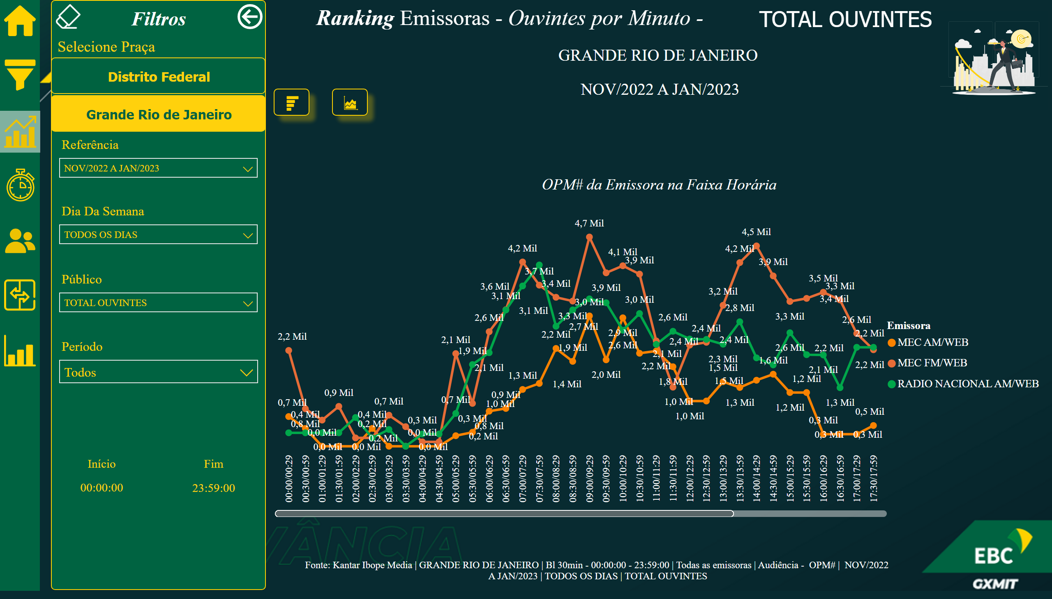
07_RJ
Notes:
actionButton
No alt text provided
actionButton
No alt text provided
actionButton
No alt text provided
Borracha
No alt text provided
Início
No alt text provided
Fim
No alt text provided
Dic_Zona
No alt text provided
textbox
No alt text provided
shape
No alt text provided
Botão_RJ
No alt text provided
Botão_DF
No alt text provided
Selecione Praça
No alt text provided
Botão_Voltar
No alt text provided
Seg_Publico
No alt text provided
Seg_Período
No alt text provided
Período
No alt text provided
Seg_D.Semana
No alt text provided
Im_Rank
No alt text provided
Im_Eixo
No alt text provided
OPM# da Emissora na Faixa Horária
No alt text provided
image
No alt text provided
shape
No alt text provided
Icon_TMED
No alt text provided
Icon_Evolucao
No alt text provided
Icon_Comparativo
No alt text provided
Icon_Menu
No alt text provided
Icon_Ranking
No alt text provided
Icon_Perfil
No alt text provided
Icon_Home
No alt text provided
Fonte_2
No alt text provided
card
No alt text provided
card
No alt text provided
advanceCardE03760C5AB684758B56AA29F9E6C257B
No alt text provided
textbox
No alt text provided
lineChart
No alt text provided
lineChart
No alt text provided
lineChart
No alt text provided
image
No alt text provided
image
No alt text provided
shape
No alt text provided
image
No alt text provided
image
No alt text provided
image
No alt text provided
image
No alt text provided
image
No alt text provided
image
No alt text provided
image
No alt text provided
card
No alt text provided
textbox
No alt text provided
advanceCardE03760C5AB684758B56AA29F9E6C257B
No alt text provided
card
No alt text provided
card
No alt text provided
clusteredBarChart
No alt text provided
slicer
No alt text provided
slicer
No alt text provided
actionButton
No alt text provided
actionButton
No alt text provided
actionButton
No alt text provided

Slide 16
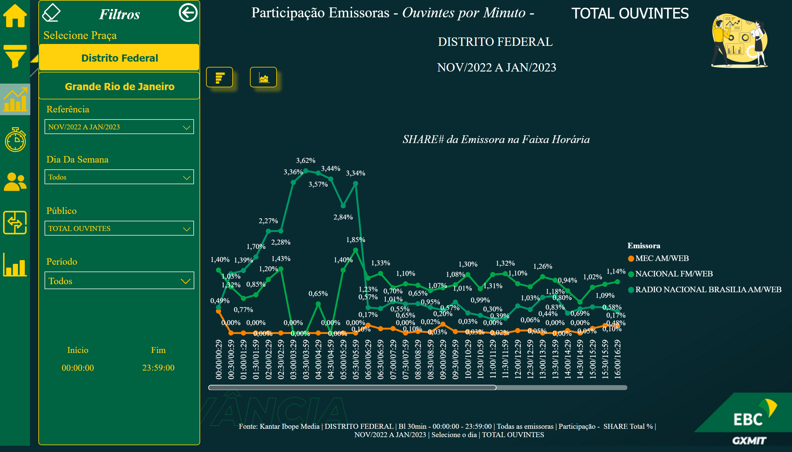
08_DF
Notes:
actionButton
No alt text provided
Borracha
No alt text provided
Im_Rank
No alt text provided
Im_Eixo
No alt text provided
textbox
No alt text provided
shape
No alt text provided
Dic_Zona
No alt text provided
Botão_RJ
No alt text provided
Botão_DF
No alt text provided
Selecione Praça
No alt text provided
Botão_Voltar
No alt text provided
Seg_Publico
No alt text provided
Seg_Período
No alt text provided
Período
No alt text provided
Seg_D.Semana
No alt text provided
Fim
No alt text provided
Início
No alt text provided
SHARE# da Emissora na Faixa Horária
No alt text provided
image
No alt text provided
shape
No alt text provided
Icon_TMED
No alt text provided
Icon_Evolucao
No alt text provided
Icon_Comparativo
No alt text provided
Icon_Menu
No alt text provided
Icon_Ranking
No alt text provided
Icon_Perfil
No alt text provided
Icon_Home
No alt text provided
Fonte_2
No alt text provided
card
No alt text provided
card
No alt text provided
advanceCardE03760C5AB684758B56AA29F9E6C257B
No alt text provided
textbox
No alt text provided
lineChart
No alt text provided
lineChart
No alt text provided
lineChart
No alt text provided
image
No alt text provided
image
No alt text provided
shape
No alt text provided
image
No alt text provided
image
No alt text provided
image
No alt text provided
image
No alt text provided
image
No alt text provided
image
No alt text provided
image
No alt text provided
card
No alt text provided
textbox
No alt text provided
advanceCardE03760C5AB684758B56AA29F9E6C257B
No alt text provided
image
No alt text provided
card
No alt text provided
card
No alt text provided
actionButton
No alt text provided
actionButton
No alt text provided
slicer
No alt text provided
slicer
No alt text provided
actionButton
No alt text provided
actionButton
No alt text provided
actionButton
No alt text provided

Slide 17
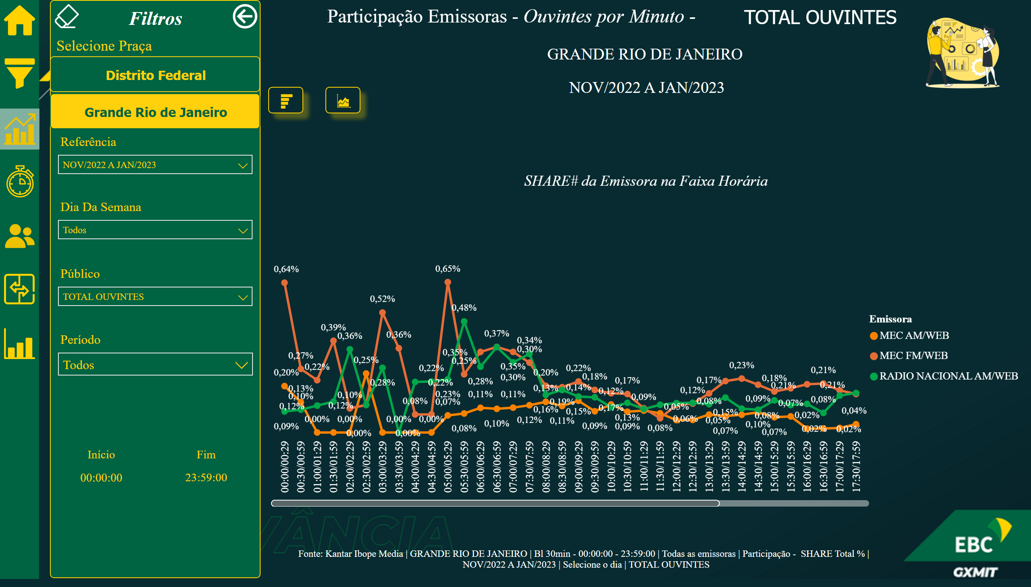
08_RJ
Notes:
actionButton
No alt text provided
Borracha
No alt text provided
Im_Rank
No alt text provided
Im_Eixo
No alt text provided
textbox
No alt text provided
shape
No alt text provided
Dic_Zona
No alt text provided
Botão_RJ
No alt text provided
Botão_DF
No alt text provided
Selecione Praça
No alt text provided
Botão_Voltar
No alt text provided
Seg_Publico
No alt text provided
Seg_Período
No alt text provided
Período
No alt text provided
Seg_D.Semana
No alt text provided
Fim
No alt text provided
Início
No alt text provided
SHARE# da Emissora na Faixa Horária
No alt text provided
image
No alt text provided
shape
No alt text provided
Icon_TMED
No alt text provided
Icon_Evolucao
No alt text provided
Icon_Comparativo
No alt text provided
Icon_Menu
No alt text provided
Icon_Ranking
No alt text provided
Icon_Perfil
No alt text provided
Icon_Home
No alt text provided
Fonte_2
No alt text provided
card
No alt text provided
card
No alt text provided
advanceCardE03760C5AB684758B56AA29F9E6C257B
No alt text provided
textbox
No alt text provided
lineChart
No alt text provided
lineChart
No alt text provided
lineChart
No alt text provided
image
No alt text provided
image
No alt text provided
shape
No alt text provided
image
No alt text provided
image
No alt text provided
image
No alt text provided
image
No alt text provided
image
No alt text provided
image
No alt text provided
image
No alt text provided
card
No alt text provided
textbox
No alt text provided
advanceCardE03760C5AB684758B56AA29F9E6C257B
No alt text provided
image
No alt text provided
card
No alt text provided
card
No alt text provided
actionButton
No alt text provided
actionButton
No alt text provided
slicer
No alt text provided
slicer
No alt text provided
actionButton
No alt text provided
actionButton
No alt text provided
actionButton
No alt text provided

